Slide 1

Predicting House Prices Using Linear Regression
Submitted by:
Group 1:
Aarushi Singh: 2201020601
Sthita Prajnah
Patra :2201020598

Slide 2
Objective and goals
  Goal: Predict median house values using real-world features.
  Why? Helps in real estate decision-making, urban planning, and price estimation.
  Real estate prices are often unpredictable and volatile.
  Buyers, investors, and planners lack reliable, data-driven insights.
  Geographic and socio-economic factors significantly influence housing value.
  There’s a need for transparent and interpretable prediction models.

Slide 3
Dataset Overview
  Source: California Housing Survey
  Records: 20,000+ observations from various districts
  Target variable: median_house_value
  Features include:
  median_income, total_rooms, population, households
  housing_median_age, latitude, longitude, etc.
  Rich mix of demographic and geographic variables

Slide 4
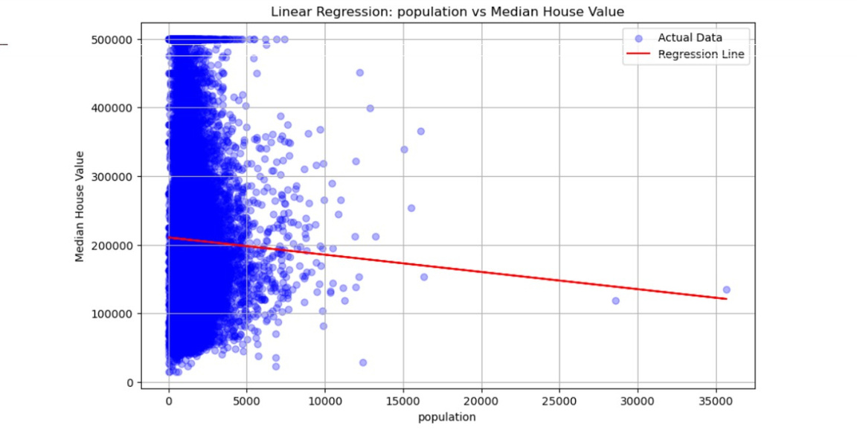
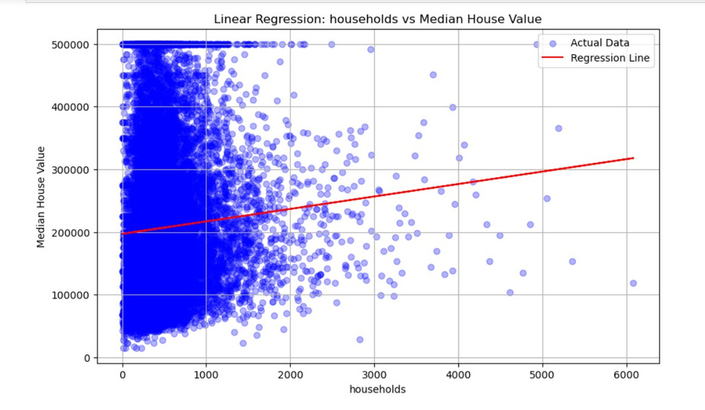


Linear regression using one variable
Observation
  population and households had poor correlation
  High variance and multicollinearity affected results
  Geographic and economic features were more reliable

Slide 5
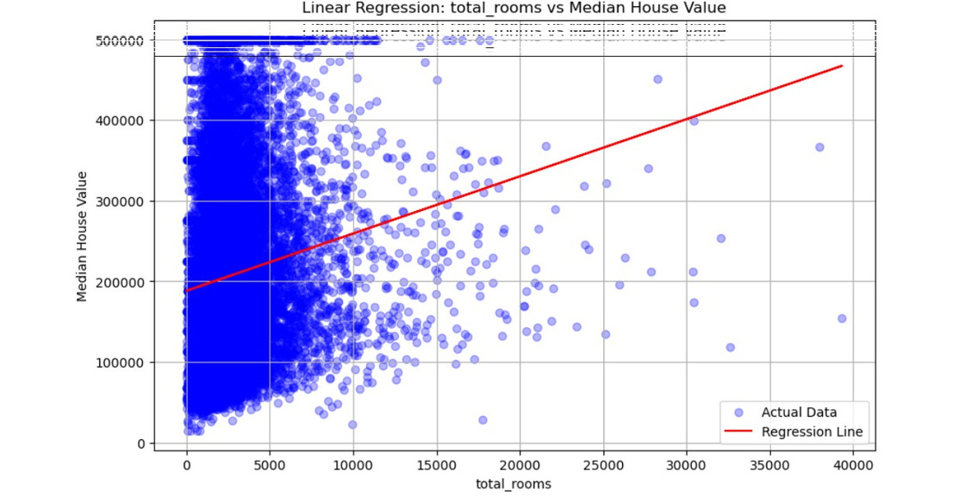
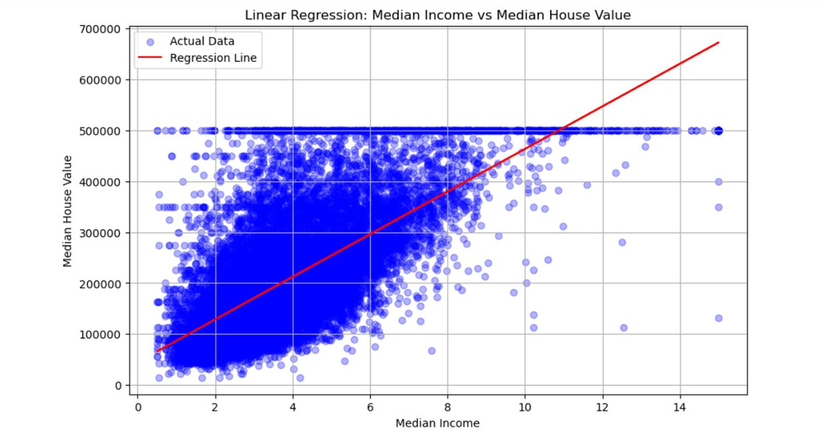


Linear regression using one variable
Observation:
  median_income showed strongest correlation.
  total_rooms had weak predictive power alone.

Slide 6
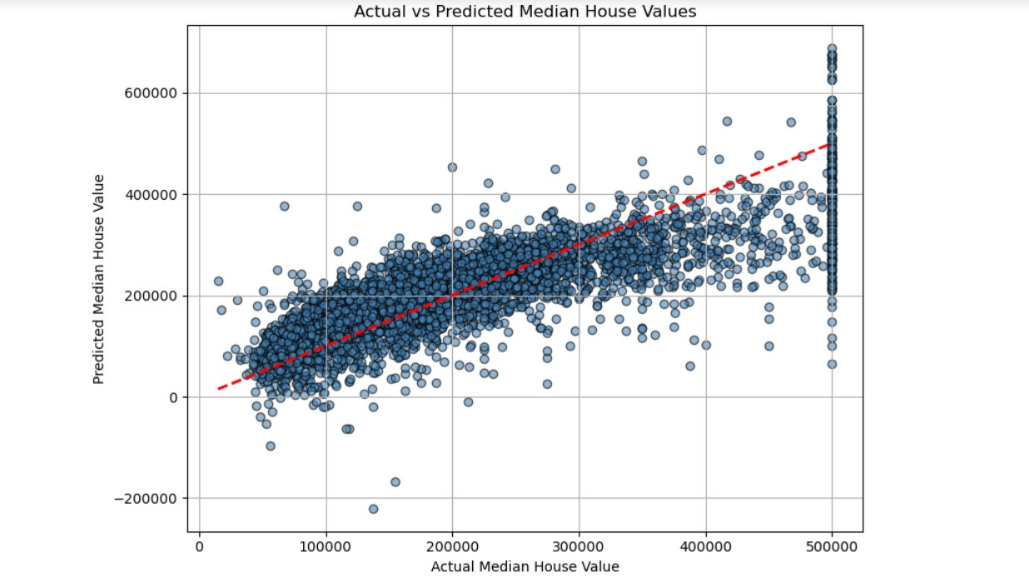

Linear regression using Multiple features
Insights:
  The model now explains 62.05% of the variance in median house prices—a noticeable improvement over the previous feature set.
  MAE and RMSE have decreased, suggesting the model makes more accurate predictions.
  Adding relevant features like total rooms, population, and households enhanced the predictive power.
Features Used:
  median_income
  housing_median_age
  latitude
  longitude
  total_rooms
  population
  households

Slide 7
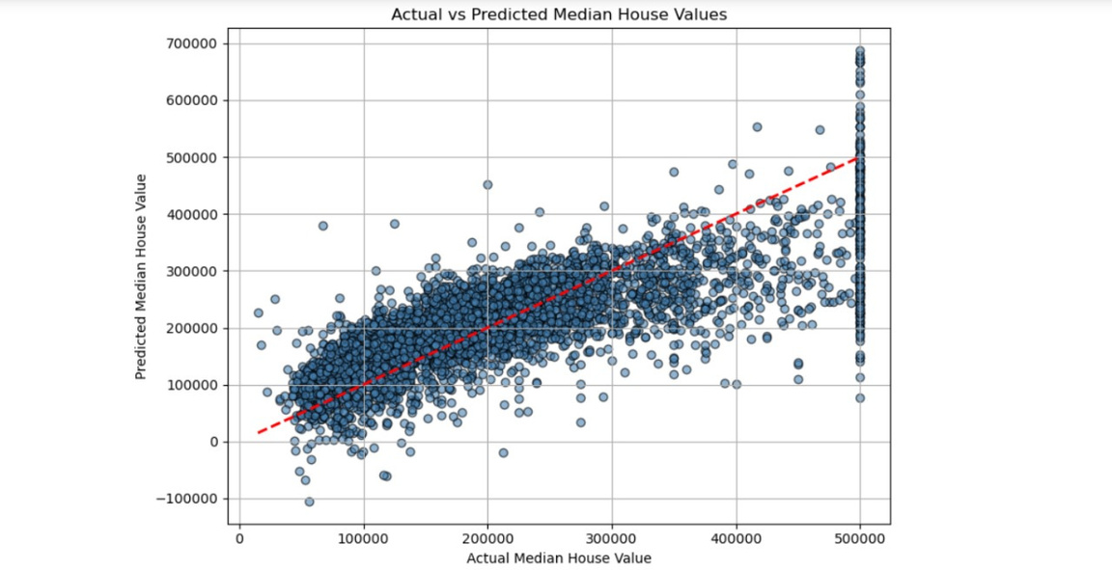
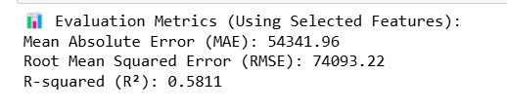
Linear regression using Multiple features
Insights:
  The model explains approximately 58.1% of the variance in house values using just 4 features.
  Moderate error values indicate a reasonable performance, though not highly precise.
  There's room for improvement—possibly by adding more relevant features or using advanced models.
  Using only four features, the model achieves an R² of around 58%, showing it captures over half the variability in house prices. While this is a strong baseline, we can improve it further by incorporating more features or tuning the model.
Features Used:
  median_income
  housing_median_age
  latitude
  longitude

Slide 8
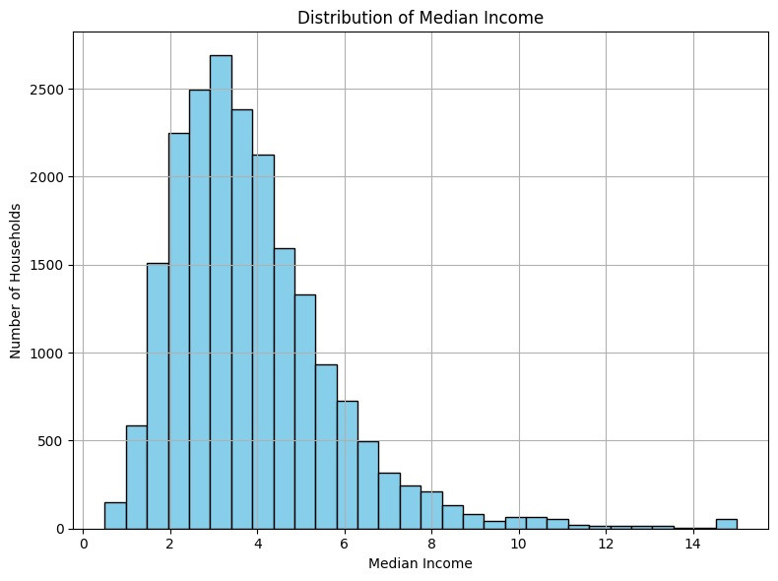

Linear regression interpretation using histogram using one variable
  median_income is a strong predictor of median_house_value because:
  Higher income usually leads to more expensive homes.
  This clear distribution helps the model learn patterns easily.
  The skew can explain why some predictions may have large errors if high-income areas are underrepresented.
  "The majority of California households earn between $20,000–$60,000, with only a few high-income regions.
  This concentrated income range makes median_income a powerful predictor of house prices."

Slide 9
Conclusion
Initially, using only 4 features (median_income, housing_median_age, latitude, longitude),
the model achieved:
R² = 0.5811 (58.11% variance explained)MAE = 54,341.96RMSE = 74,093.22
After extending to 7 features (adding total_rooms, population, and households), the model improved to:
R² = 0.6205 (62.05% variance explained)MAE = 51,657.47RMSE = 70,517.83
📈 Key Takeaway:
Feature selection significantly impacts model performance.
Carefully adding contextually relevant features boosts accuracy and reduces prediction error.
🧠 Final Insight:
The model still has room for improvement—future steps could include:Feature engineeringHandling outliers

