Slide 1

California Housing Data
AI & DS
Submitted By :
NAME | REGD. NUMBER
SUPRIYA SAHOO | 2201020438
SMRUTI RANJAN SAHOO | 2201020417
SUBHASMITA DASH | 2201020422
SHREYA TRIPATHI | 2201020261

Slide 2
INTRODUCTION
The dataset contains 20,640 rows and 10 columns, each representing a housing block in California. It includes geographical features (longitude, latitude), housing characteristics (housing_median_age, total_rooms, total_bedrooms, households), demographic data (population, median_income), and the target variable: median_house_value. The ocean_proximity column is categorical, indicating how close a location is to the ocean. Only total_bedrooms has missing values (207 entries); the rest are complete. This dataset is often used for predictive modeling, exploratory analysis, and studying housing trends.

Slide 3
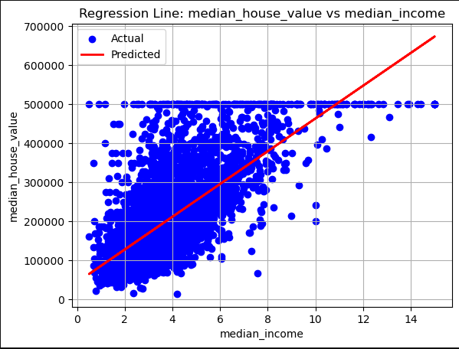
Median House Value VS Median Income
INTERPRETATION
Positive Correlation: The graph shows a clear positive correlation — higher median income areas generally have higher median house values.
Prediction Error: There’s visible deviation between actual and predicted values, especially at the high end (where actual values level off but the line keeps rising).
The regression model captures the general trend but fails to account for saturation or non-linearity in house values.

Slide 4
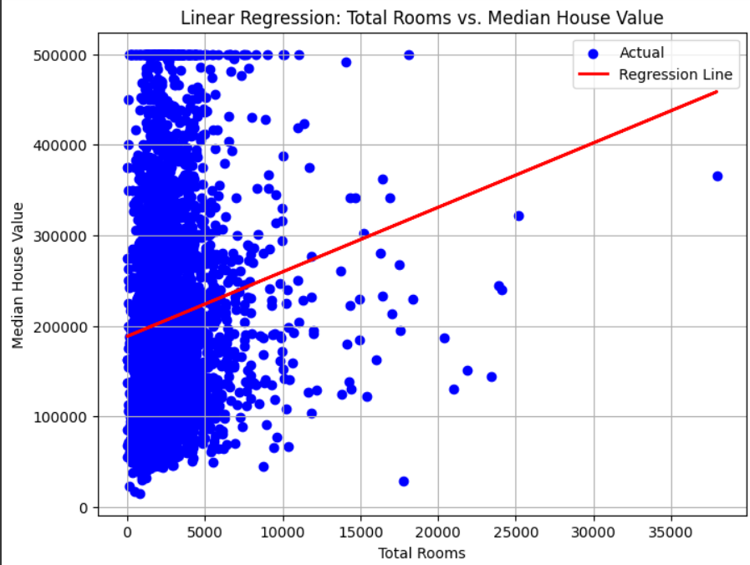
Total Rooms VS Median Income
INTERPRETATION
Weak Linear Relationship: Although the line slopes upward, the actual data is highly scattered.
Outliers & Skewed Data: A log transformation on the x-axis might help better visualize the data.
The regression line shows a positive but weak relationship between total rooms and median house value.

Slide 5
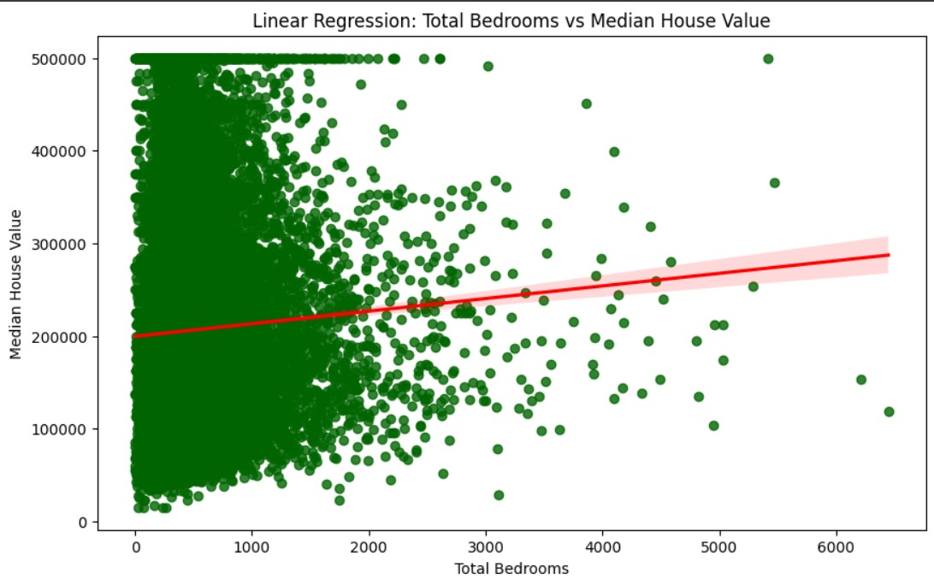
Total Bedrooms VS Median Income
INTERPRETATION
Weak Linear Relationship: Although the line slopes upward, the actual data is highly scattered.
Outliers & Skewed Data: A log transformation on the x-axis might help better visualize the data.
The regression line shows a positive but weak relationship between total rooms and median house value.

Slide 6
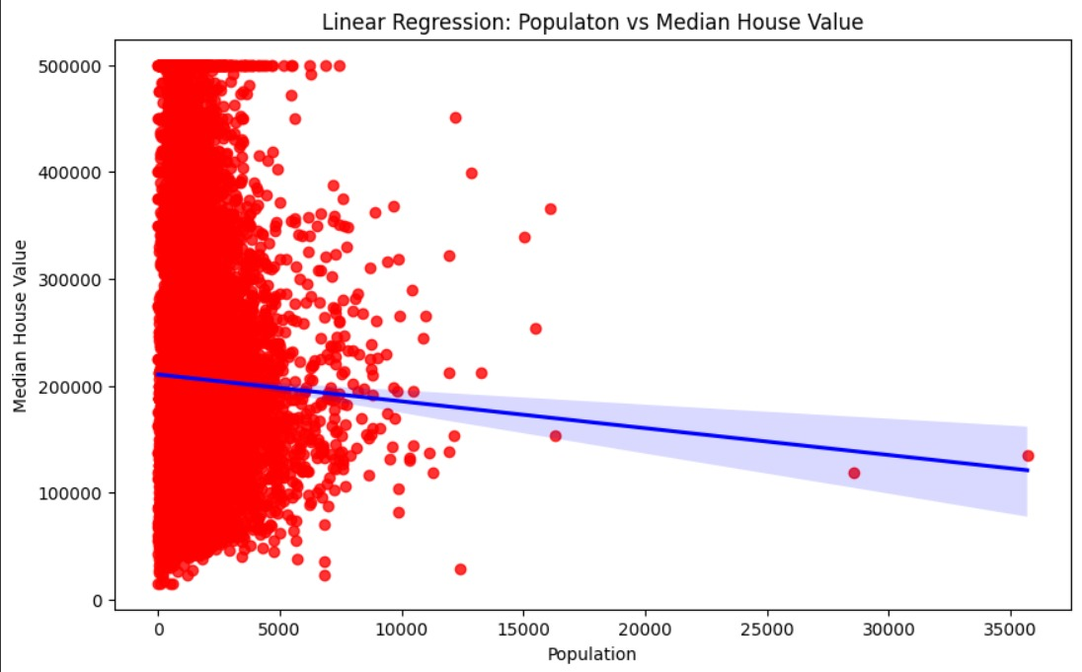
Population VS Median Income
INTERPRETATION
Negative Correlation: House prices tend to be higher in Southern California (lower latitude).
High Variance: Even at the same latitude, house values vary widely. Indicates other factors (e.g., income, proximity to coast, crime rate, school quality) significantly influence prices.
Weak Predictive Power: Latitude alone is not a strong predictor of house value. The regression line does not fit the data tightly — indicating low R² (coefficient of determination).
There is a slight downward trend — homes tend to be more expensive in southern regions of California.

Slide 7
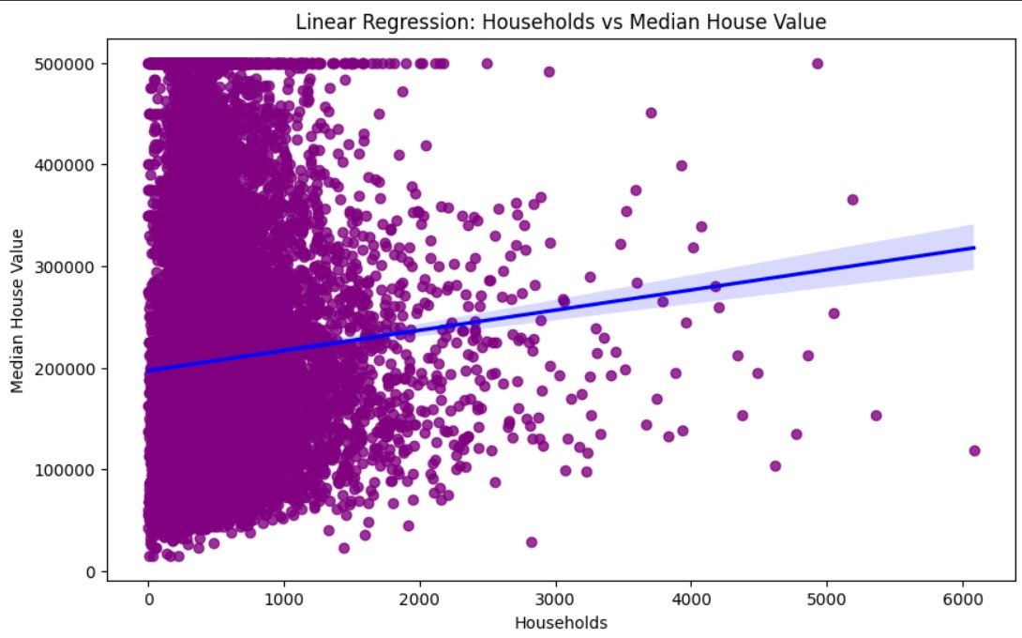
Households VS Median Income
INTERPRETATION
Weak Positive Correlation: The regression line suggests that as the number of households increases, median house value tends to increase slightly.
Potential Explanation: Areas with more households might have more developed infrastructure or urban settings, leading to higher property values.
Variance & Outliers: Outliers exist on both ends, particularly high-value homes with a low number of households and vice versa.

Slide 8
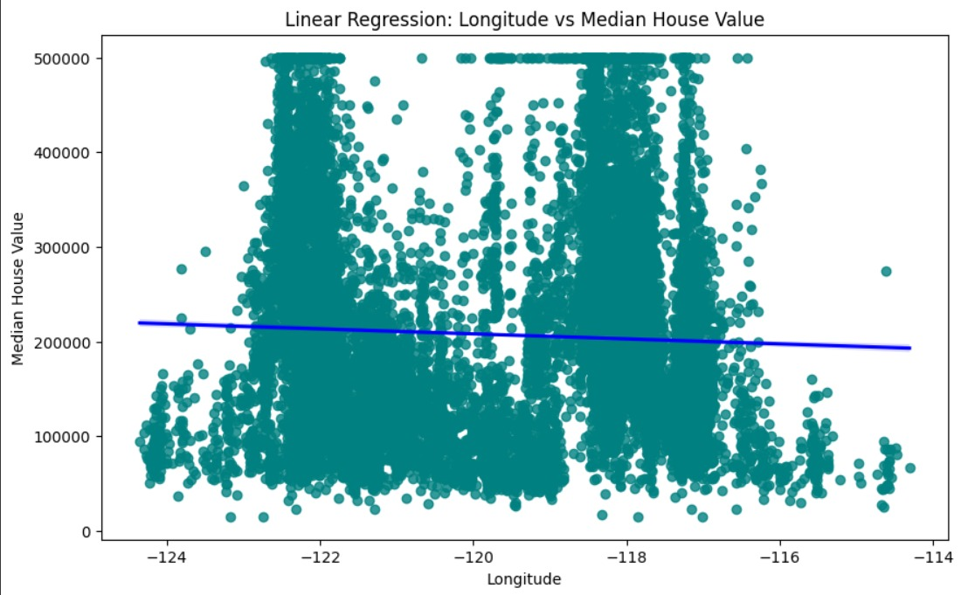
Longitude VS Median Income
INTERPRETATION
Negative Correlation: The west coast (lower longitude) areas are associated with higher house values.
High Variance: Significant vertical spread at each longitude — house value varies greatly within the same region.
Not Ideal for Prediction Alone: Longitude alone is not sufficient to predict house value due to other influencing factors (income, proximity to coast, amenities, etc.).

Slide 9
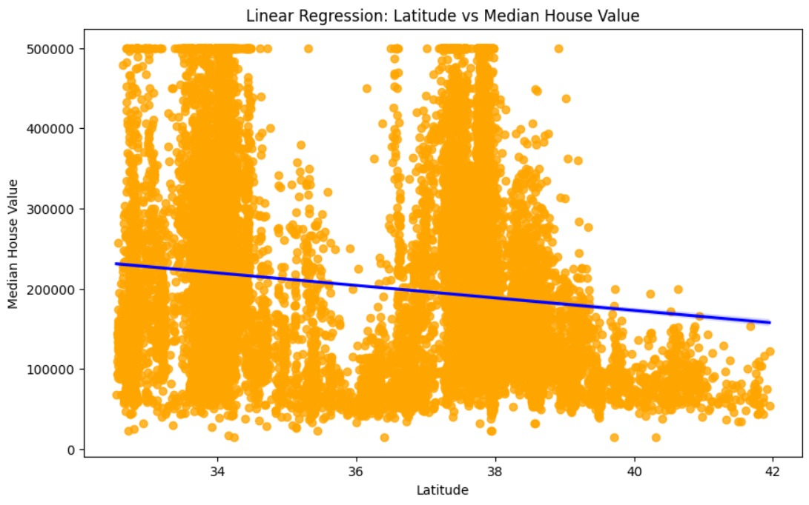
latitude VS Median Income
INTERPRETATION
Negative Correlation: House prices tend to be higher in Southern California (lower latitude).
High Variance: Even at the same latitude, house values vary widely. Indicates other factors (e.g., income, proximity to coast, crime rate, school quality) significantly influence prices.
Weak Predictive Power: Latitude alone is not a strong predictor of house value. The regression line does not fit the data tightly — indicating low R² (coefficient of determination).
There is a slight downward trend — homes tend to be more expensive in southern regions of California.

Slide 10
CONCLUSION
From the analysis of all the linear regression plots, it is evident that median income has the strongest positive correlation with median house value, making it the most significant predictor among the variables. Features like total rooms and households show moderate positive relationships, while total bedrooms and housing median age have weaker positive correlations.
.

Slide 11

THANK YOU

