Slide 1
Predict Housing Prices Using Single Linear Regression
Group: 11
Name Reg. No.
Swagat Pritam Sahoo 2201020425
Valin Mahapatra 2201020429
Suvakanta Rout 2201020424
Somnath Mahapatra 2201020419

Slide 2
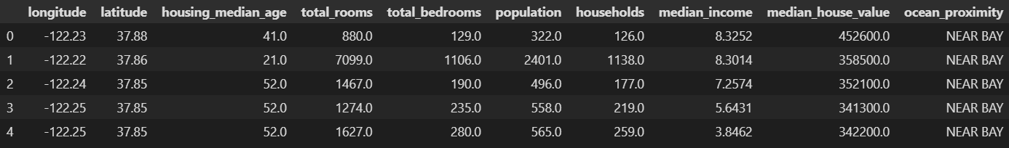
Data Frame

Slide 3
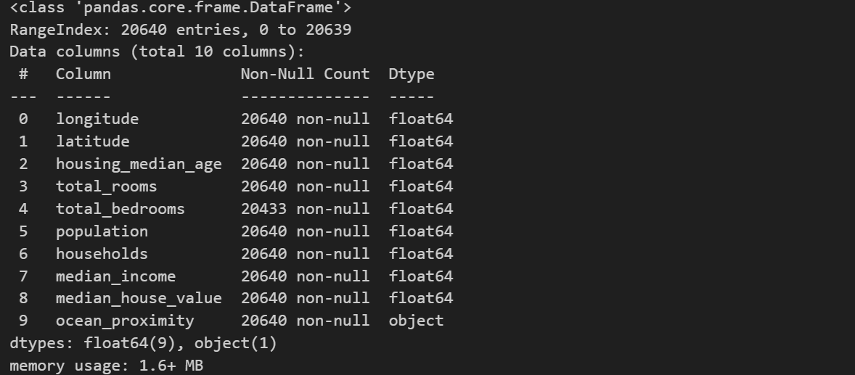
structure of dataset

Slide 4



Task 1:
Building a single-variable linear regression model to predict median_house_value using median_income .

Slide 5
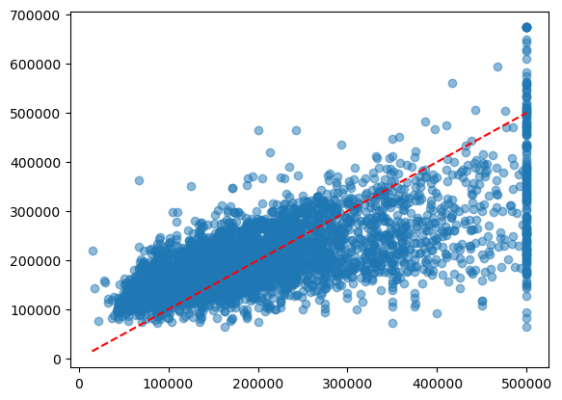
COMPARE ACTUAL VALUES (y_test) WITH PREDICTED VALUE (y_pred)

Slide 6
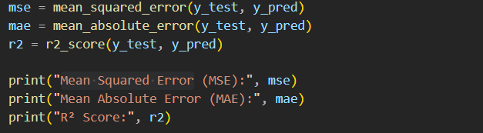

Mean Squared Error, Mean Absolute Error and R-Squared Score:

Slide 7

Task 2:
Build a simple linear regression model to predict median_house_value based on a single feature total_rooms.

Slide 8
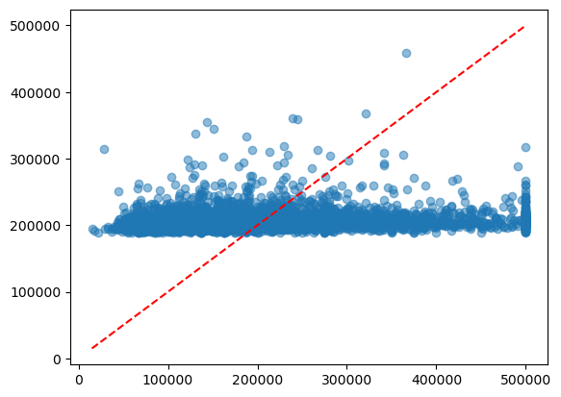
COMPARE ACTUAL VALUES (y_test) WITH PREDICTED VALUE (y_pred)

Slide 9
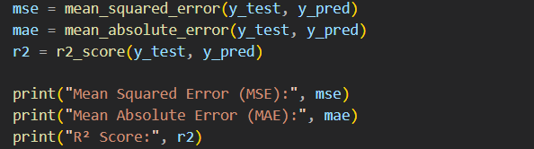

Mean Squared Error, Mean Absolute Error and R-Squared Score:

Slide 10
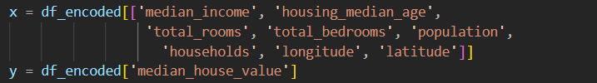
Task 3:
Build a multivariate linear regression model to predict median_house_value using multiple input features.

Slide 11
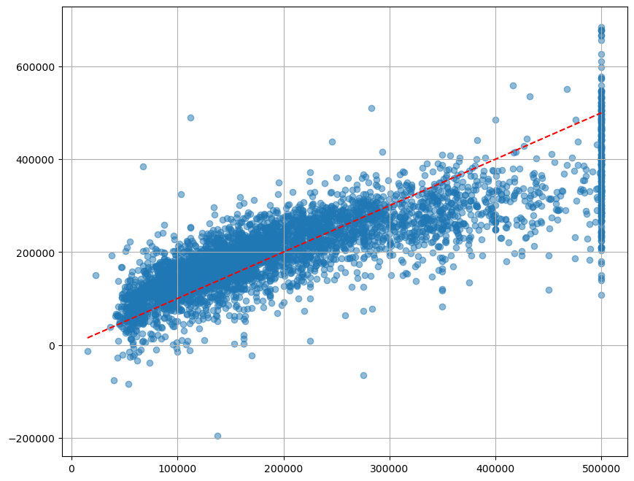
COMPARE ACTUAL VALUES (y_test) WITH PREDICTED VALUE (y_pred)

Slide 12

Mean Squared Error, Mean Absolute Error and R-Squared Score:

Slide 13
Thank You

