Slide 1
Predict House Value Based on Total Rooms
NAME :- ABINASH BHOI(2201020971)
PRABHUDATTA PATRA(2201020836)
SANTANU KUMAR SAHOO (2201020256)
ABHILIPSA SWAIN(2301030094)

Slide 2
Introduction
This project aims to predict housing prices in California using Multivariate Linear Regression, a supervised machine learning technique. By analyzing various features such as median income, housing age, total rooms, population, and geographical location, we develop a model to estimate the median house value accurately. The approach helps uncover relationships between these features and property prices. Such predictive modeling is valuable in real estate planning, economic studies, and urban development. The simplicity and interpretability of linear regression make it an ideal choice for understanding how multiple variables together influence housing prices in a practical and data-driven way.

Slide 3
Objective
To develop a machine learning model that accurately estimates the median house value based on multiple input variables such as:
Median household income
Age of the houses
Number of rooms and bedrooms
Population and household size
Geographical coordinates (longitude, latitude)

Slide 4
Model Training
Model Used: Linear Regression
Libraries: pandas, numpy, scikit-learn
Training Done On: 80% of the dataset
Goal: Learn weights to minimize prediction error

Slide 5
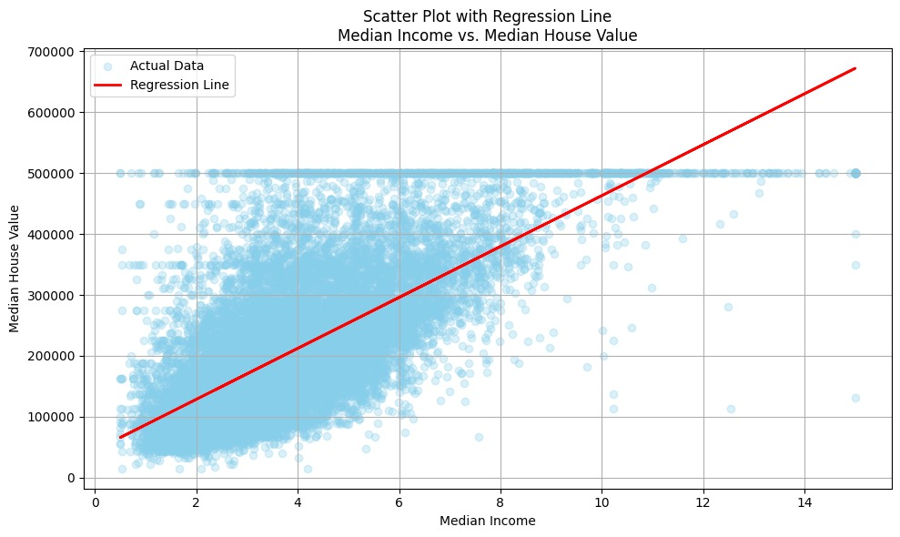
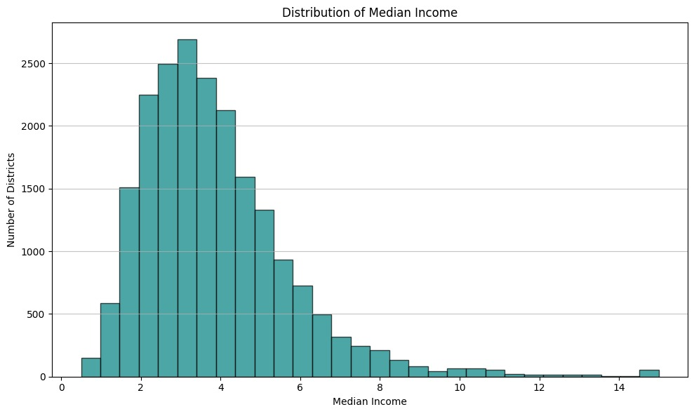
Predictions & Evaluation

Slide 6
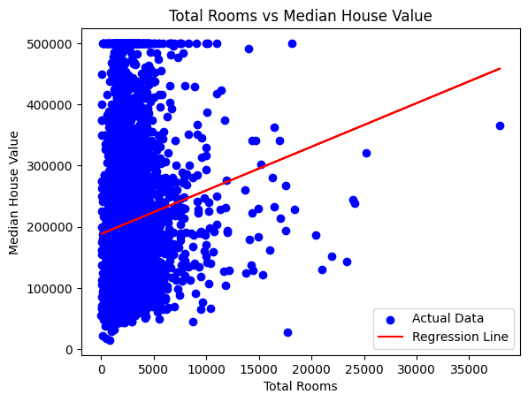
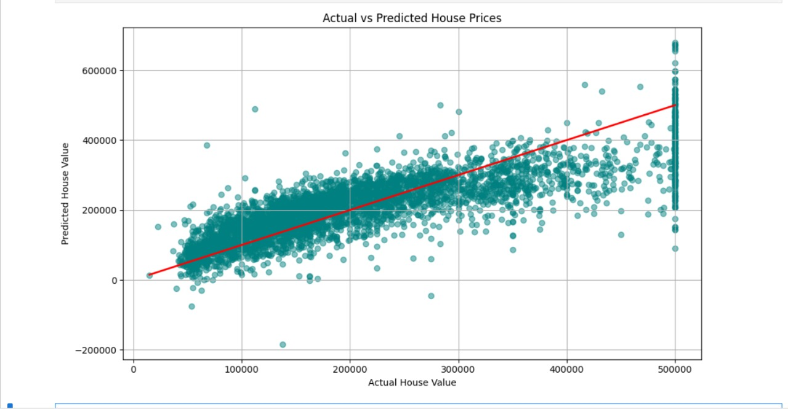

Slide 7
