Slide 1

A Machine Learning Approach to Predict California Housing Prices. This presentation analyzes key factors affecting median house values and builds a predictive model.
Soumyaranjan Sahoo Vijay Kumar Mahato PratikMohanty Pritanshu

Slide 2
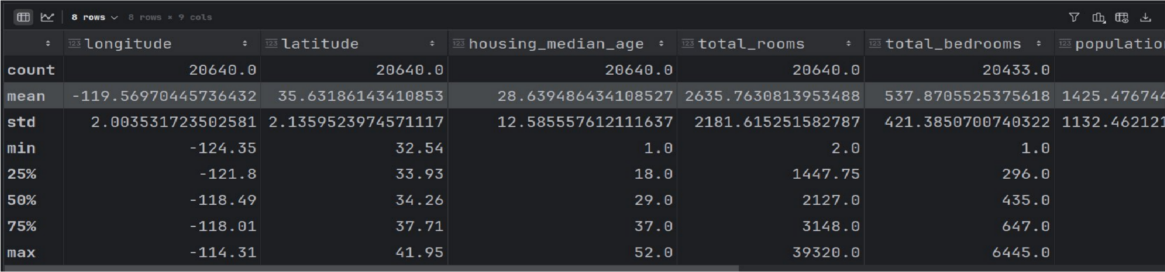
Objective & Data
Identify factors influencing house prices
Use correlation & regression
Key features: income, rooms, population, proximity
Derived features: rooms/household, pop/household

Slide 3
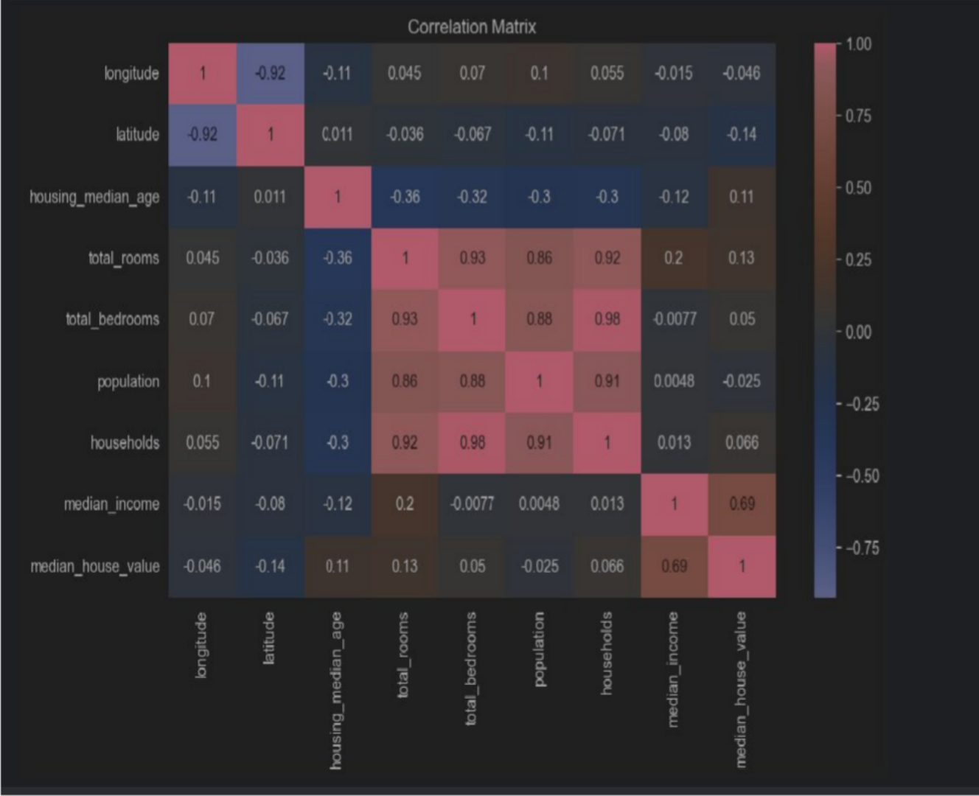
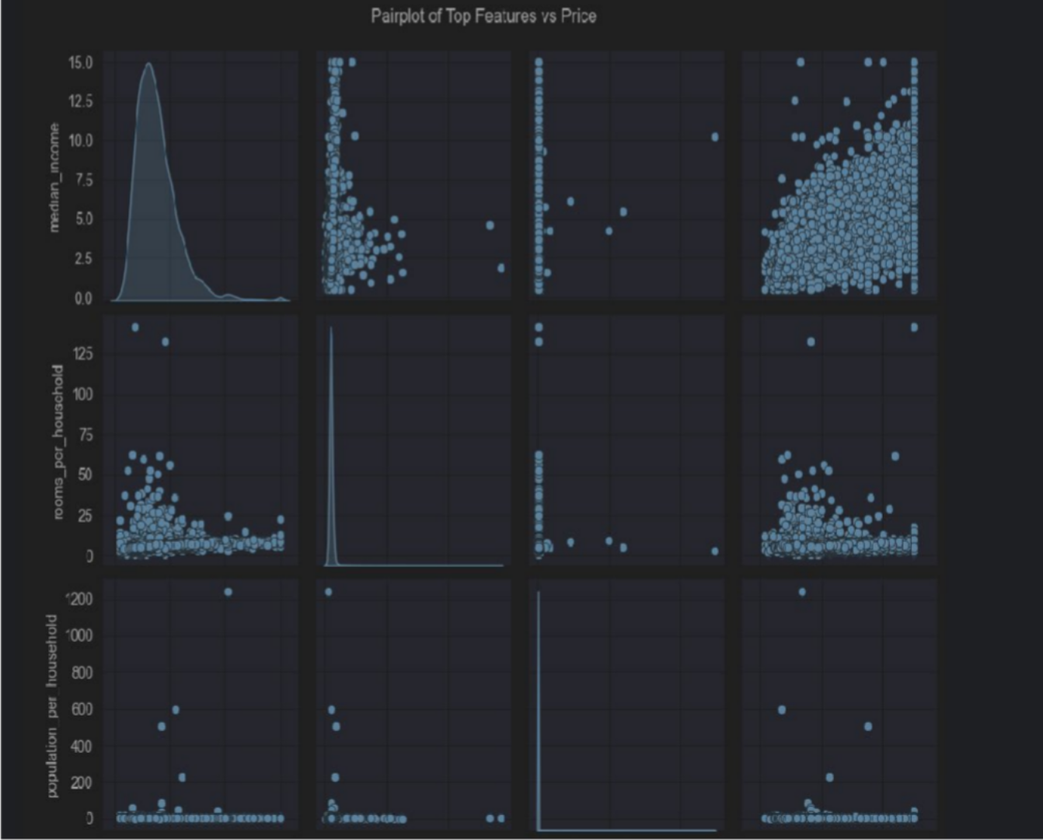
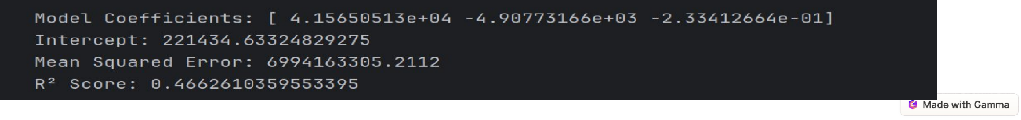
Insights & Model

Slide 4
Step-by-Step: How to Identify the Most Useful Features
1. Correlation Matrix (for Linear Relationships)
This gives a quick idea of how strongly each feature is linearly related to the target
o Interpretation:
Features with high absolute correlation values (close to +1 or -1) with the target
are more promising.
Example:
From typical housing data:
median_income → □ Strongest correlation with price
latitude / longitude → Moderate
housing_median_age, total_rooms → Weak or noisy
o Most Predictive Feature:
median_income — consistently ranks #1 in both correlation and model importance.
□ Why?
Higher income areas tend to have more expensive housing. It directly reflects purchasing power & market value.
o Engineered Features like:
rooms_per_household
population_per_household bedrooms_per_room
These often boost accuracy because they normalize raw counts, giving better insights.

Slide 5
Real-World Applications
Investment Analysis
Urban Planning
Home Buyers
Investors can identify undervalued properties. This can inform profitable real estate investments. Predictive models enable smarter decisions.
Cities can predict housing demand. This helps plan infrastructure and zoning.
The result is improved urban development.
Buyers can assess fair market value. This enables confident purchase offers. Informed decisions lead to satisfaction.

Slide 6
Conclusion
🔍 Key Takeaways:
Median Income is the strongest predictor of house prices, showing a clear positive correlation.
Engineered features like Rooms per Household and Population per Household further improved prediction accuracy.
Geographical location (latitude and longitude) also plays a critical role — especially properties near the coast, which tend to be more expensive.
📈 Model Insights:
A Linear Regression model was built using top features, achieving a good balance of simplicity and interpretability.
The model can predict housing prices based on a few meaningful and well- correlated features.

