Slide 1
Predicting House Prices with Income:
A Linear Approach
SUBMITTED BY:
NAME | REGISTRATION NO.
J KIRAN PRABHA | 2201020684

Slide 2
INTRODUCTION
This dataset contains housing information for over 20,000 districts .Some key columns include:median_income: the median income of households in the districtmedian_house_value: the target variable we want to predictOther features include geographic and demographic details like population, total rooms, and proximity to the oceanT

Slide 3
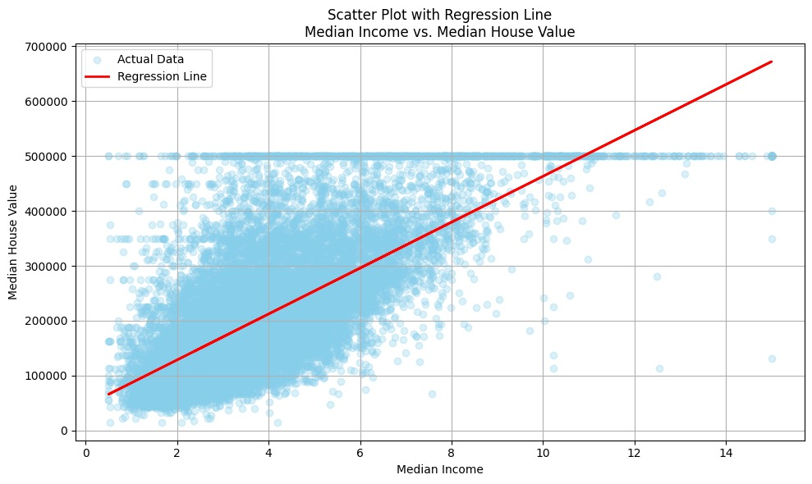
GRAPH
From this graph, we clearly see that income and house value are positively correlated

Slide 4
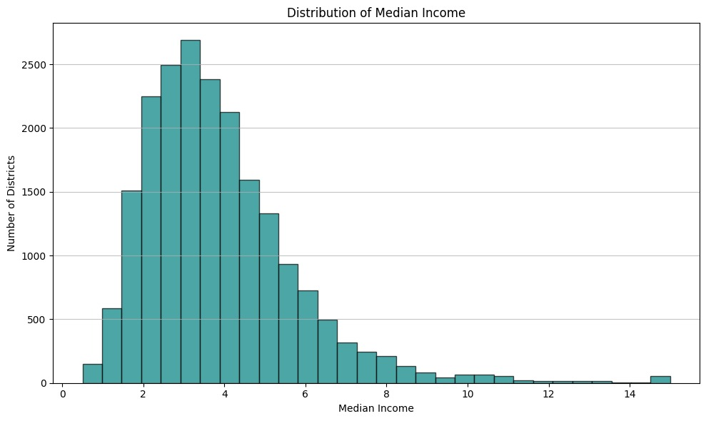
DISTIBUTION OF MEDIAN INCOME
From this histogram, we observe that most of them have a median income between 2 and 5 units.

Slide 5
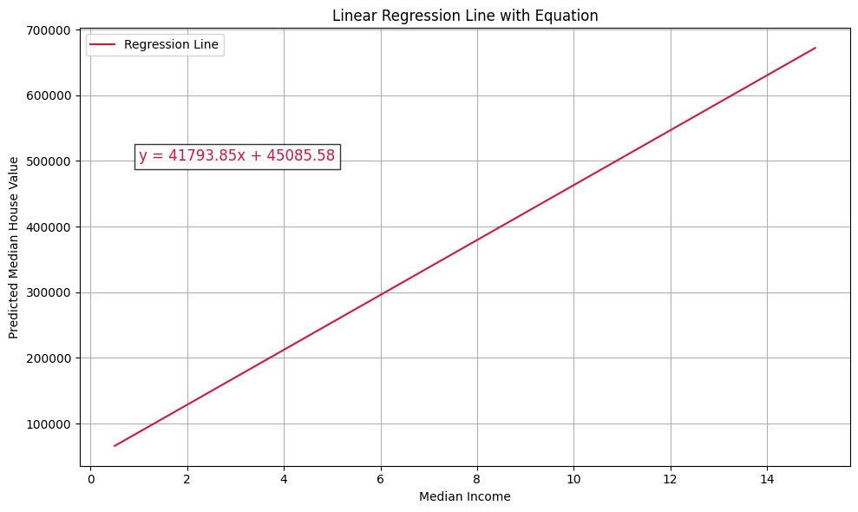
LINEAR REGRESSION LINE WITH EQUATION
This graph shows our final regression model as a simple linear equation. It tells us that for every unit increase in median income, the predicted house value increases by approximately X dollars. This line helps us forecast house prices based on income levels, making the model interpretable and useful for real-world planning

Slide 6
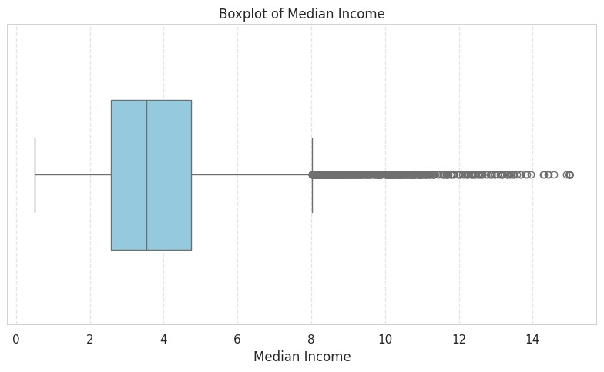
BOXPLOT OF MEDIAN INCOME
This boxplot shows the distribution of median income across districts. The majority of districts fall within a narrow income range, while a few high-income outliers stretch far beyond. This tells us that while most of the population has a moderate income, certain districts could heavily influence the model if not accounted for.

Slide 7
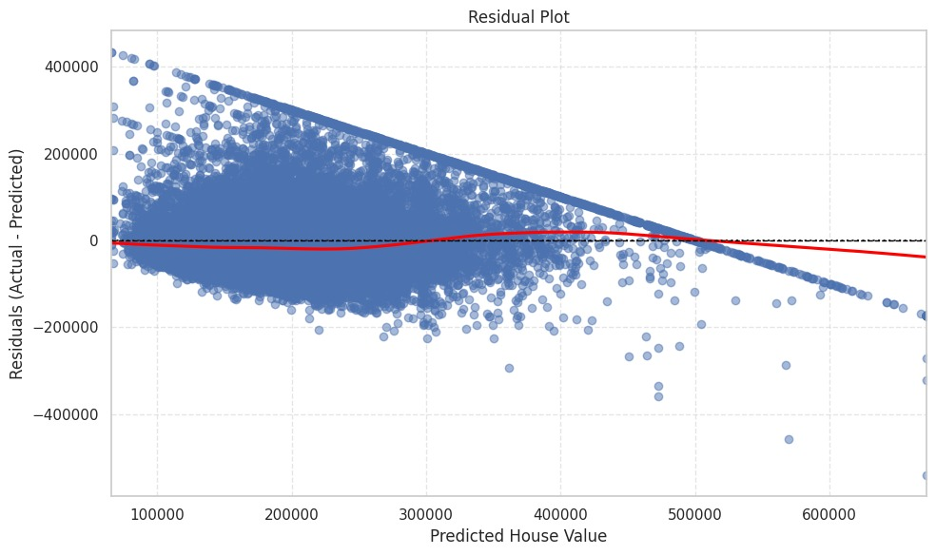
RESIDUAL PLOT
This residual plot helps us evaluate how well our model is predicting house prices. Ideally, the residuals should be randomly scattered around zero — indicating a good fit. In our case, [mention what you observed], which suggests that [your interpretation — e.g., linear model is reasonable, or further refinement may be needed]

Slide 8
CONCLUSION
In this project, we explored how median income influences house values using a simple linear regression model. Our analysis revealed a strong positive relationship, where higher income levels generally lead to higher house values. Through various visualizations like scatter plots, histograms, boxplots, and residual plots, we gained a clear understanding of the data distribution and model performance. The regression line provided an easy-to-understand equation for predicting house prices. However, the residual plot highlighted that linear models may not fully capture all patterns, especially at extreme income levels. Despite this, our approach proves useful for real-world applications such as real estate planning, pricing strategies, and economic policy-making. Overall, this project demonstrates how data can be used to make informed, impactful decisions.

Slide 9
THANK YOU

