Slide 1

Predicting House Prices using Linear Regression
A comparison of features to find the best predictor
NAME | CRANES REG NO
SAHIL SINGH | CL20250106019665113
SHRUTI SINHA | CL2025010601873240
SOUMYAJIT BANERJEE | CL2025010601873643
SURAJ VERMA | CL2025010601899149

Slide 2
📊 Comparing Various Features
Brief list of features used in the Linear Regression model:
Median Income ✅
Total Rooms
Total Bedrooms
Household
Ocean Proximity (categorical)

Slide 3
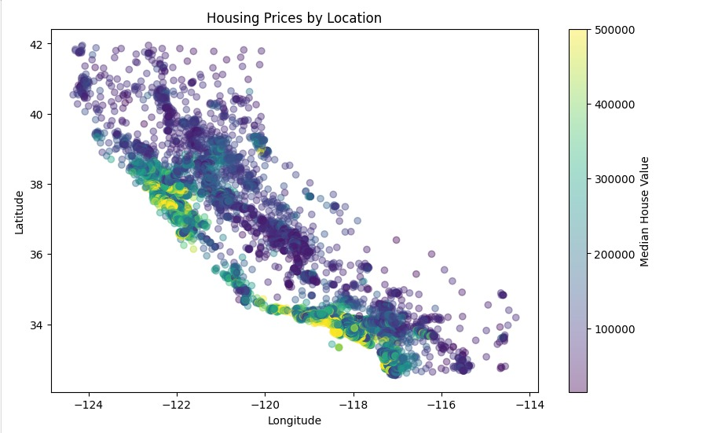
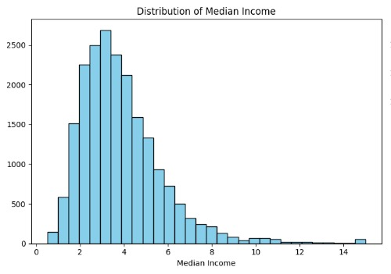
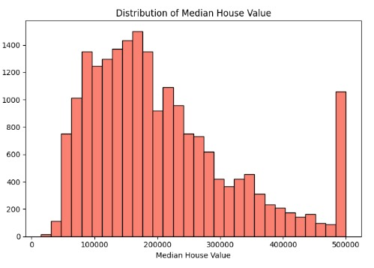
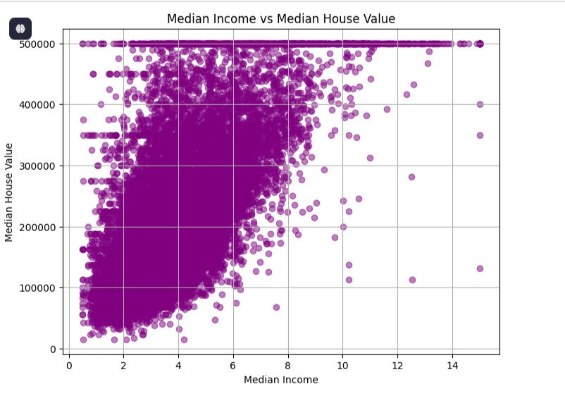
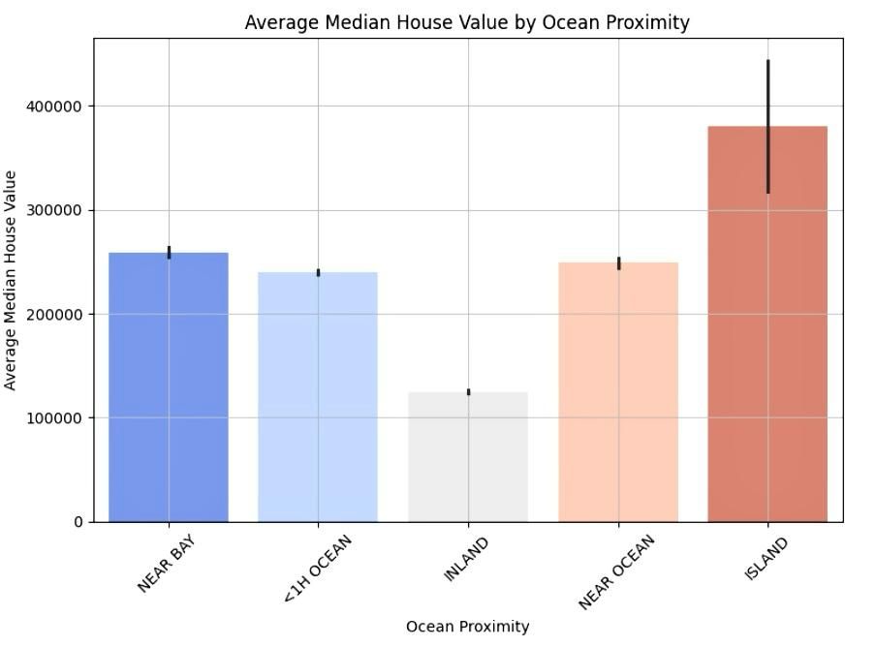
Feature Analysis
IT SHOWS THAT THE MEDIAN HOUSE VALUE INCREASES WITH DECREASE IN LATITUDE LONGITUDE
SHOWS THE NORMAL DISTRIBUTION OF MEDIAN INCOME
SHOWS THE NORMAL DISTRIBUTION OF MEDIAN HOUSE VALUE
It show that the ISLAND have the highest average median house value.
As the Median income increases the Median House Value also increases

Slide 4
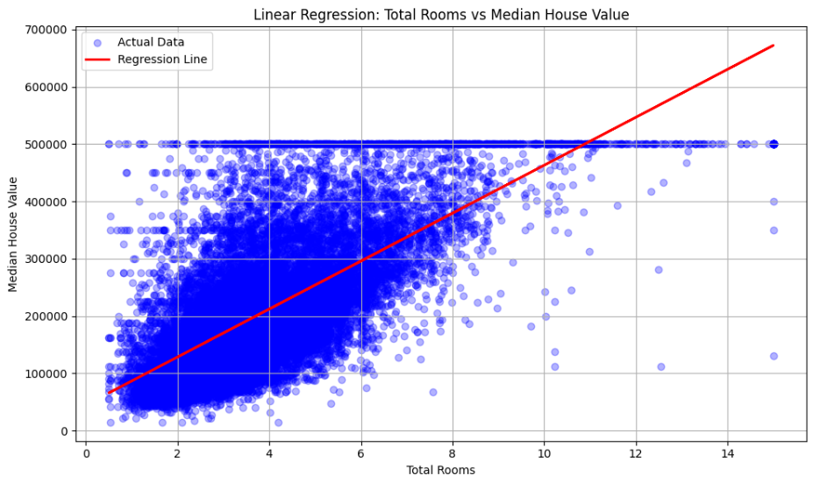
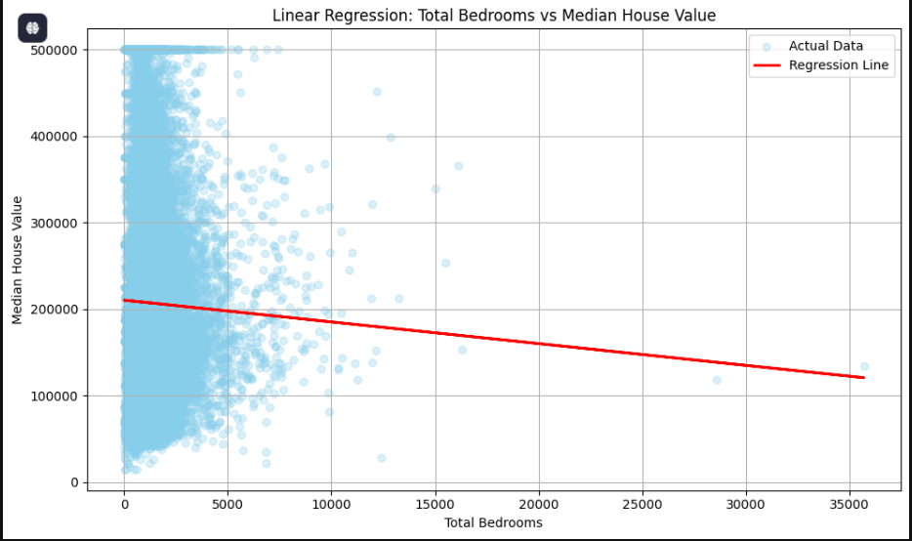
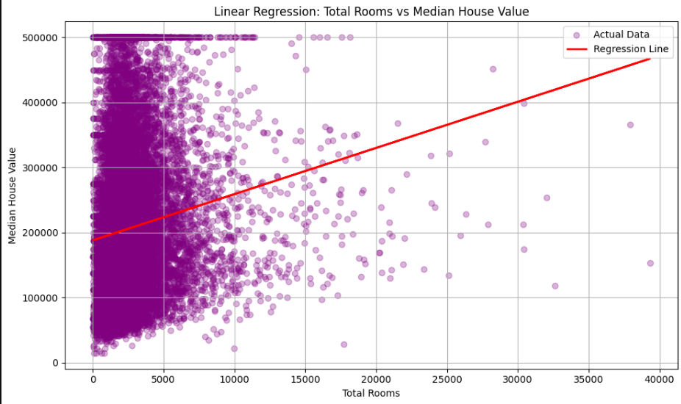
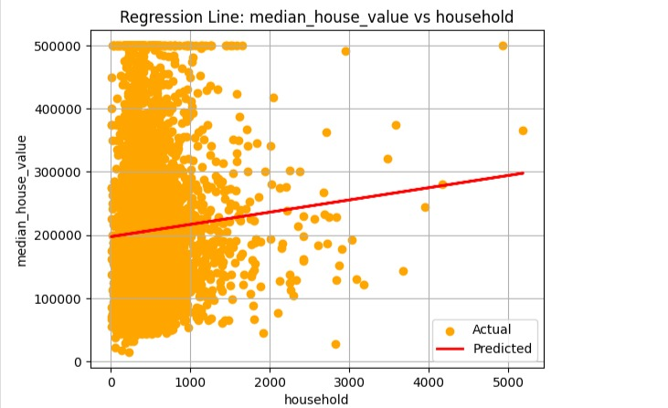
Prediction of Median House Value with different features using Simple Linear Regression

Slide 5

COMPARISON OF THE VARIOUS TESTED FEATURES
Feature
MAE (↓)
RMSE (↓)
R² Score (↑)
Conclusion
median_income
✅ 62625.93
✅ 83733.57
✅ 0.473
🏆 Best
total_rooms
89931.67
114349.34
0.014
❌ Weak
total_bedrooms
91153.82
115357.75
0.00060
❌ Weak
household
13035576594.34
90218.25
0.0053
❌ Weak
ocean_proximity
90620.23
114747.33
0.011
❌ Weak

Slide 6

Summary:
We tested 5 different features.
Median income was the most accurate single predictor.
Future Idea: Improve the model by combining features using multiple regression techniques.

Slide 7
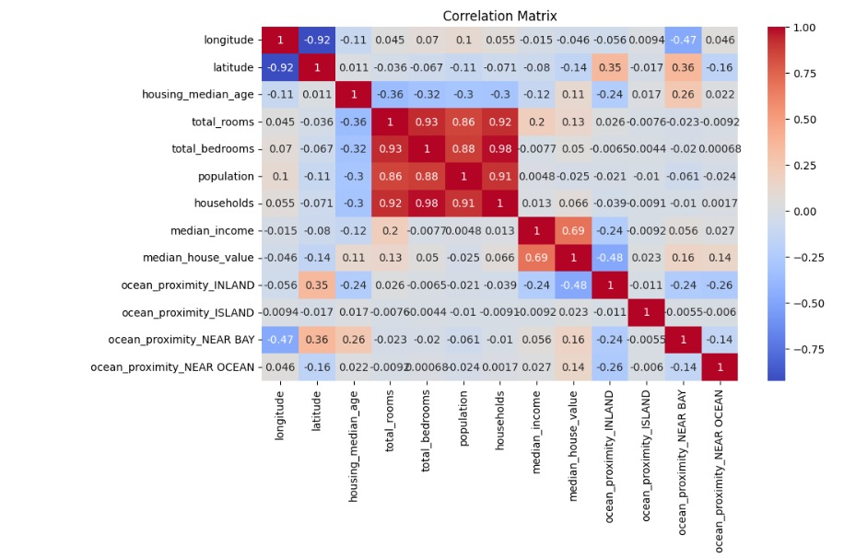
UNDERSTANDIING THROUGH A CO-RELATION GRAPH
IT SHOWS THAT THE TOTAL BED ROOMS ARE HIGH CO RELATED THAN OTHER FEATURES LIKE TOTAL ROOMS AND HOUSEHOLD WHICH LEADS TO MULTICOLLINERAITY RISK…

Slide 8
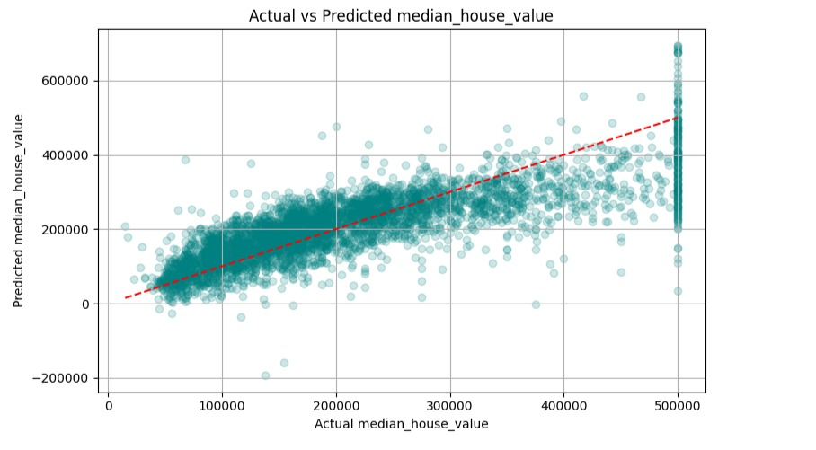
MULTI LINEAR REGRESSION INCLUDING ALL THE FEATURES:
MSE : 4908576721.15 MAE : 50670.76 R2 SCORE : 0.621
THIS SHOW THAT THE MODEL EXPLAINS 62% OF THE VARIANTION IN MEDIAN HOUSE VALUE

Slide 9
MULTI LINEAR REGRESSION REMOVING TOTAL BEDROOMS:
MSE : 4838614541.15 MAE : 50492.50 R2 SCORE : 0.637
THIS SHOW THAT THE MODEL EXPLAINS 64% OF THE VARIANTION IN MEDIAN HOUSE VALUE

