Slide 1
PREDICTING HOUSING PRICES
TEAM MEMBERS
NAME | REGD.NO
SHREESHAN PANDA | 2201020718
ANGSHUMAN MAJHI | 2201020686
CHITTARANJAN TANTY | 2201020604

Slide 2
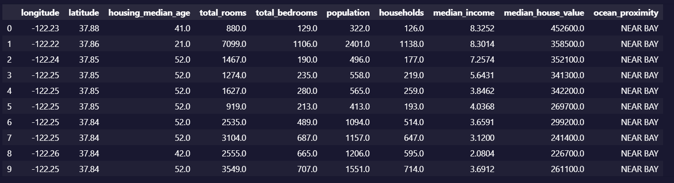
SAMPLE OF DATASET

Slide 3
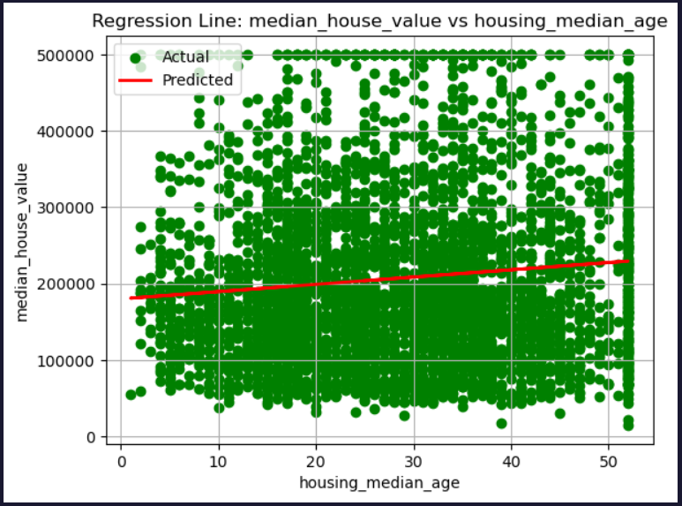
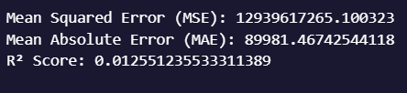
Housing_median_age vs Median_house_value
The scatter plot shows the relationship between housing median age and median house value. While there is a very slight upward trend in the red regression line, indicating a minimal positive correlation, the data points are widely scattered. This suggests that housing age has a weak impact on house value, and other features may play a more dominant role in predicting property prices.

Slide 4
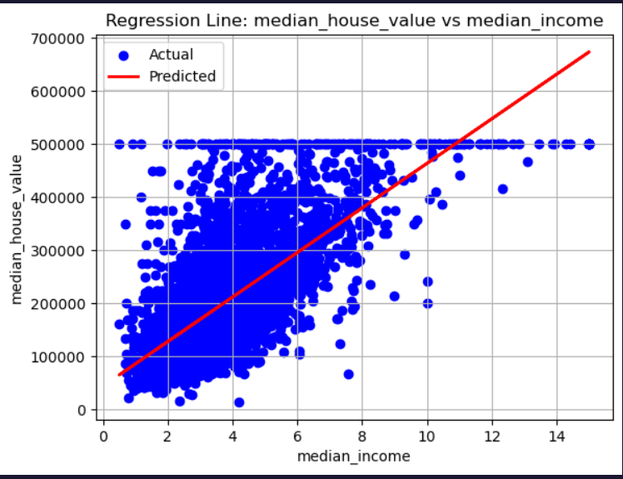
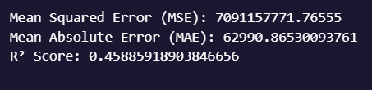
Median_income vs Median_house_value
A linear regression study of median income versus median home value is displayed in this graph. The red line is the regression line that displays the anticipated trend, and the blue dots are the actual data points. It implies that median home value often rises in tandem with median income, while the relationship becomes less linear at higher values because of a discernible cap on home prices about $500,000

Slide 5
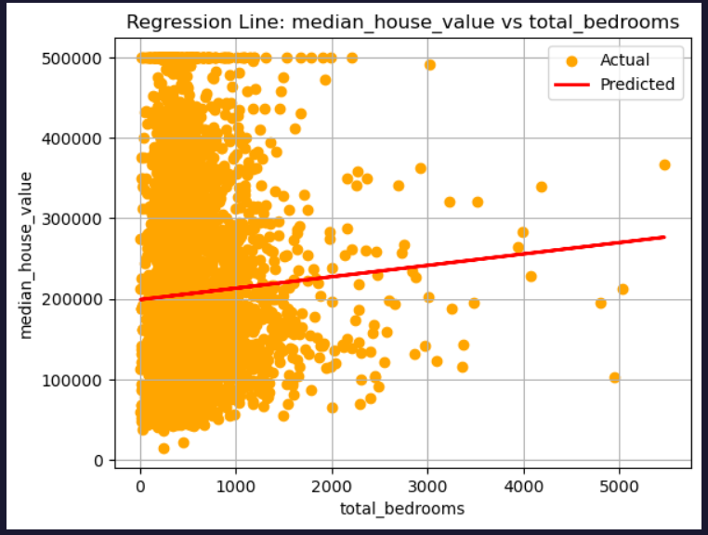

Total_bedrooms vs Median_house_value
The scatter plot on the right illustrates the starkly low linear relationship between the median property value and the number of bedrooms. The near-horizontal regression line emphasizes the statistical insignificance of the total number of bedrooms as a predictor of property value un this specific situation. This suggests that although larger homes may contain more bedrooms, underlying multicollinearity or confounding socioeconomic factors probably prevent the number of bedrooms from explaining valuation on its own.

Slide 6
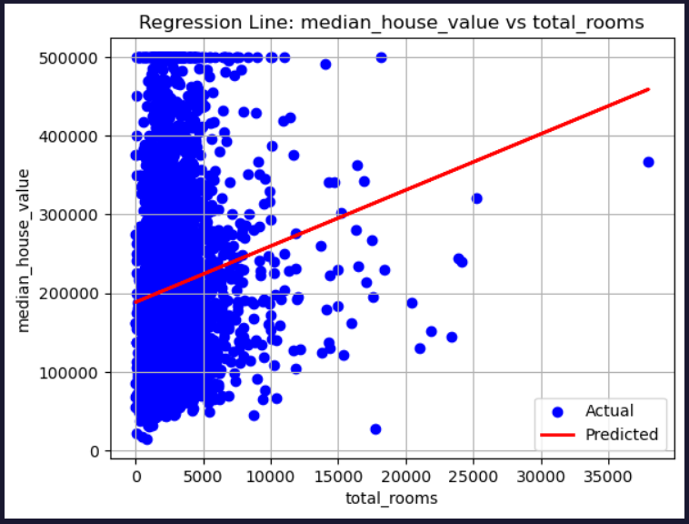
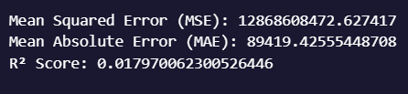
Total_rooms vs Median_house_value
The scatter plot on the right shows the glaringly small linear correlation between the number of rooms and the median house value. The statistical insignificance of the total number of rooms as a predictor of house value non this particular context is highlighted by the near-horizontal regression line. This implies that even while larger properties might have more rooms, the number of rooms by itself does not explain valuation, most likely because of underlying multicollinearity or confounding socioeconomic factors.

Slide 7
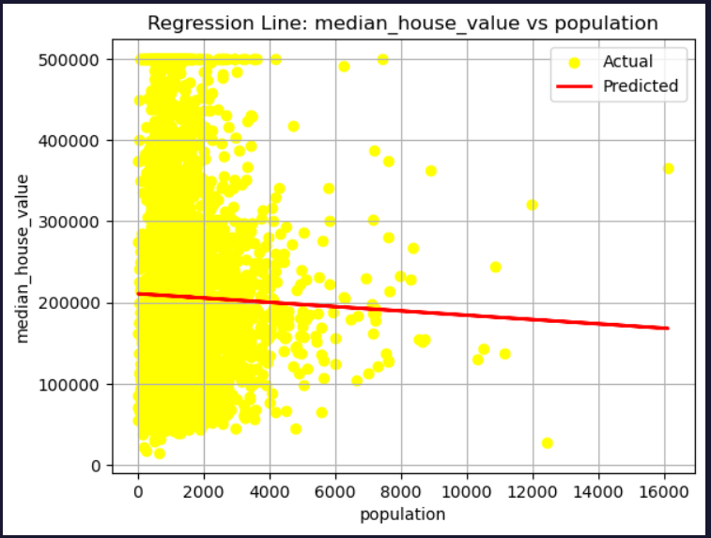

Population vs Median_house_value
The population distribution by housing median age (0–30 years) is shown in this bar chart. It demonstrates that the maximum population density is found in dwellings with a median age of 15 to 17 years, suggesting that more people live in comparatively newer housing regions. There are observable peaks around housing ages 5, 15–17, and 25–26 years, indicating an uneven distribution.

Slide 8
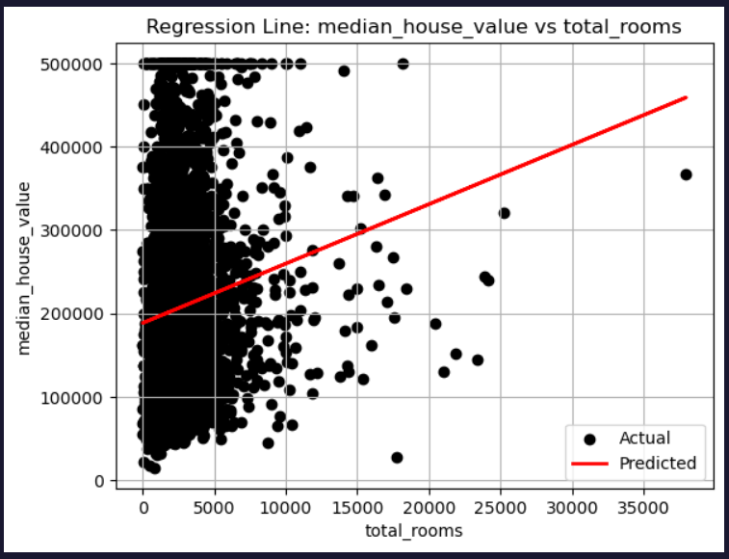
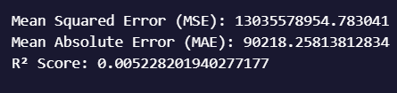
Household vs Median_house_value
The graph displays a regression analysis of the relationship between total_rooms and median_house_value in a housing dataset. The black dots represent the actual data points, showing a wide spread of house values for varying room counts. The red line indicates the linear regression model's predicted trend, suggesting a slight positive correlation between the number of rooms and house value. However, the large scatter and data concentration at the lower room counts indicate that total rooms alone may not strongly predict house value. The model oversimplifies a complex relationship.

Slide 9
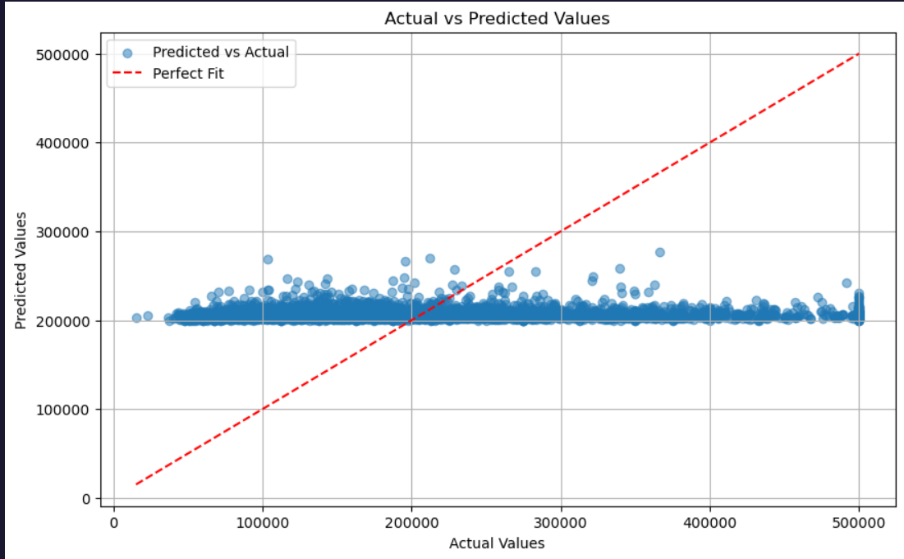

Slide 10
CONCLUSION
Visual exploration of the dataset reveals how different factors affect the median house value.
Median Income vs House Value:
There is a strong positive linear correlation between median income and median house value.
Areas with higher income levels generally have significantly higher home prices.
This suggests that income is a reliable and impactful predictor in real estate valuation models.
Total Rooms vs House Value:
There is very little correlation between total number of rooms and house value.
The regression line is nearly flat, showing that more rooms do not necessarily lead to higher property prices. Housing Age vs Population & Households:
A concentration of homes aged 15 to 17 years is observed in populated areas, suggesting a trend toward newer housing.
The population distribution by housing median age (0–30) shows higher concentrations in homes aged 15 to 17 years, indicating a preference or trend toward relatively newer housing in populated areas.
The households distribution by housing median age (0–100) further reveals a peak in household count for homes aged 15–17 years, and a distinct spike at age 52, likely due to data capping or categorization, which may warrant preprocessing attention in modeling.

