Slide 1

Prepared by group 8 AI & DS
Group Project
HOUSE HUNT

Slide 2




Team Members
Partha Sarathi Nayak
Piyush Kumar
Rahul kumar
Mohammad Esmile Dabir
2201020253
2201020713
2201020254
2201020688

Slide 3
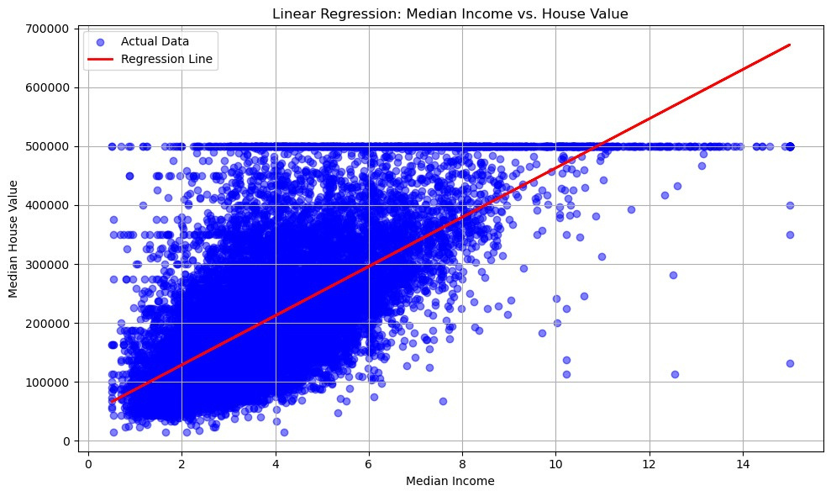
Data Analysis - Median Income VS House Value
This graph shows a linear regression analysis of median income vs. median house value. The blue dots represent actual data points, while the red line is the regression line showing the predicted trend. It suggests that as median income increases, median house value generally increases too, though the relationship becomes less linear at higher values due to a noticeable cap in house prices around $500,000.
Mean Absolute Error (MAE): 62625.93
Root Mean Squared Error (RMSE): 83733.57
R-squared (R²) Score: 0.4734

Slide 4
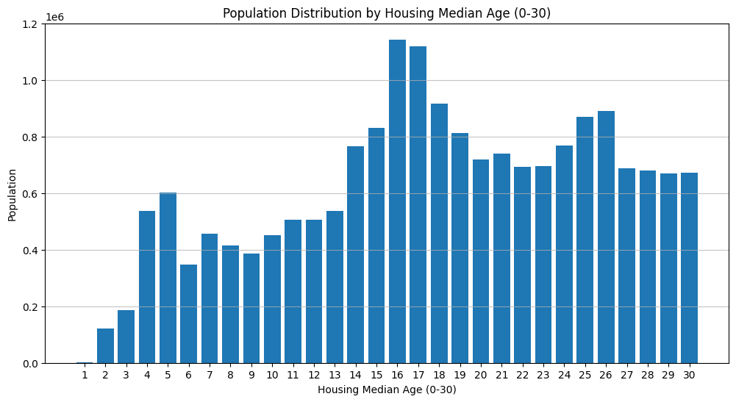
Data Analysis - Population Distribution
This bar chart displays the population distribution by housing median age (0–30 years). It shows that homes with a median age between 15 and 17 years have the highest population density, indicating a larger number of people reside in relatively newer housing areas. The distribution is uneven, with noticeable peaks around housing ages 5, 15–17, and 25–26 years.

Slide 5
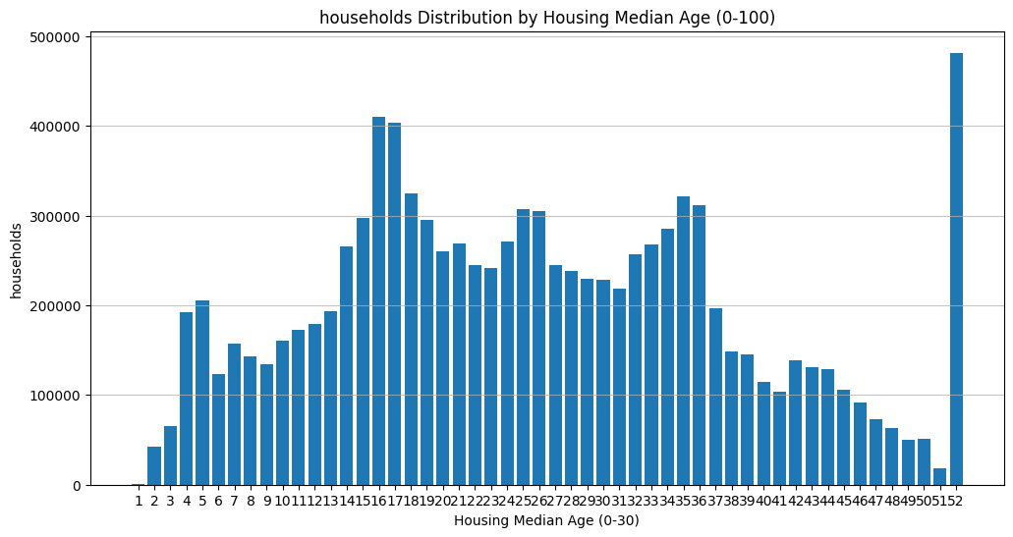
Data Analysis - Household Distribution
This bar chart shows the distribution of households by housing median age (0–100 years). A significant number of households are concentrated around 15–17 years, with a sharp spike at age 52, likely indicating an upper cap or data grouping. The distribution suggests most houses are relatively mid-aged, with fewer very new or very old houses.

Slide 6
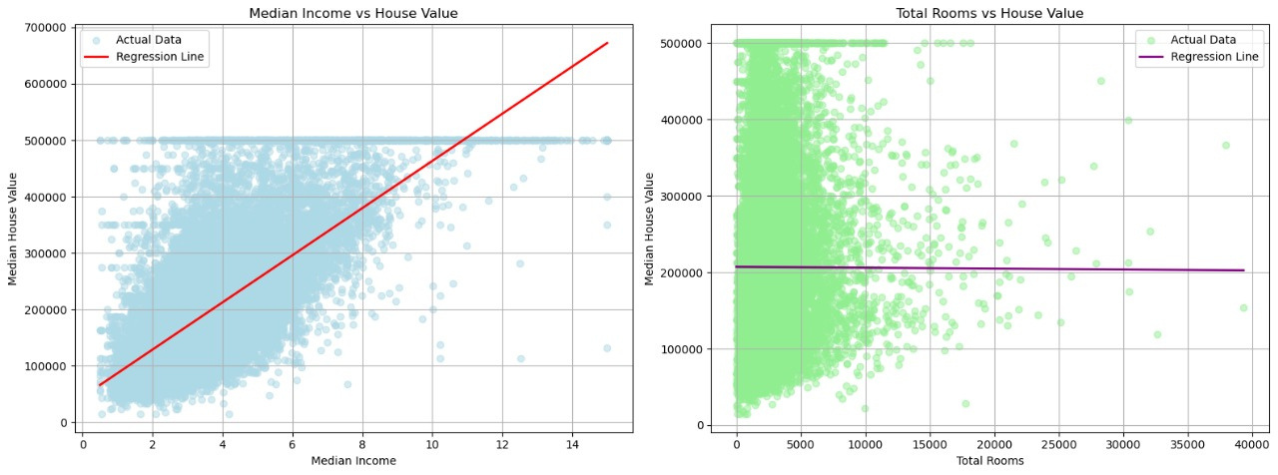
Data Analysis - Total Rooms vs House Value
The right-hand scatter plot illustrates the relationship between Total Rooms and Median House Value, revealing a conspicuously negligible linear association. The near-horizontal regression line underscores the statistical insignificance of total room count as a predictive feature for house value in this context. This suggests that, despite larger properties potentially containing more rooms, room quantity alone lacks explanatory power in influencing valuation, likely due to underlying multicollinearity or confounding socio-economic variables.
Mean Absolute Error (MAE): 89931.68
Root Mean Squared Error (RMSE): 114349.74
R-squared (R²) Score: 0.0180

Slide 7
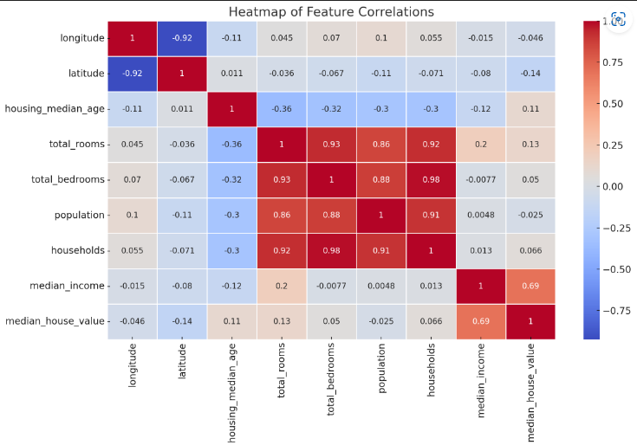
Data Analysis - Heatmap
  Median income has the strongest positive correlation (0.69) with median house value, indicating income is a key factor influencing house prices.
  Features like total rooms, total bedrooms, and households are highly intercorrelated but have weaker relationships with house value.
  Longitude and latitude show slight negative correlations with house value, hinting at geographical influences.

Slide 8
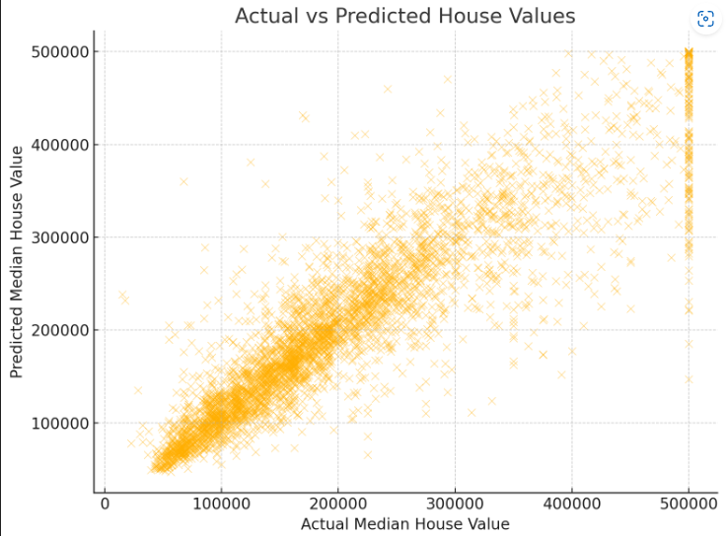
Predictions
Actual vs Predicted House Values graph. The closer the points are to the diagonal line (which would represent perfect prediction), the better the model is doing.

Slide 9
Conclusion 🔍
From the visual analyses across multiple variables influencing median house value, we derive the following insights:
  Median Income exhibits a strong positive linear relationship with house value. This indicates that regions with higher income levels tend to have significantly higher property values, making income a robust predictor in real estate valuation models.
  In contrast, Total Rooms shows a negligible correlation with house value. The regression line remains nearly flat, suggesting that simply having more rooms does not substantially impact a property's worth — likely due to factors like land size, location, or room utility being more influential.
  The population distribution by housing median age (0–30) shows higher concentrations in homes aged 15 to 17 years, indicating a preference or trend toward relatively newer housing in populated areas.
  The households distribution by housing median age (0–100) further reveals a peak in household count for homes aged 15–17 years, and a distinct spike at age 52, likely due to data capping or categorization, which may warrant preprocessing attention in modeling.

Slide 10
Thank you

