Slide 1
AI & DS PRESENTATION
GROUP-9
SUBMITTED BY:
TANUJA SHREE (2201020427)
SAURABH KUMAR MOHANTA(2201020431)
SANDEEP BISWAL (2201020443)

Slide 2
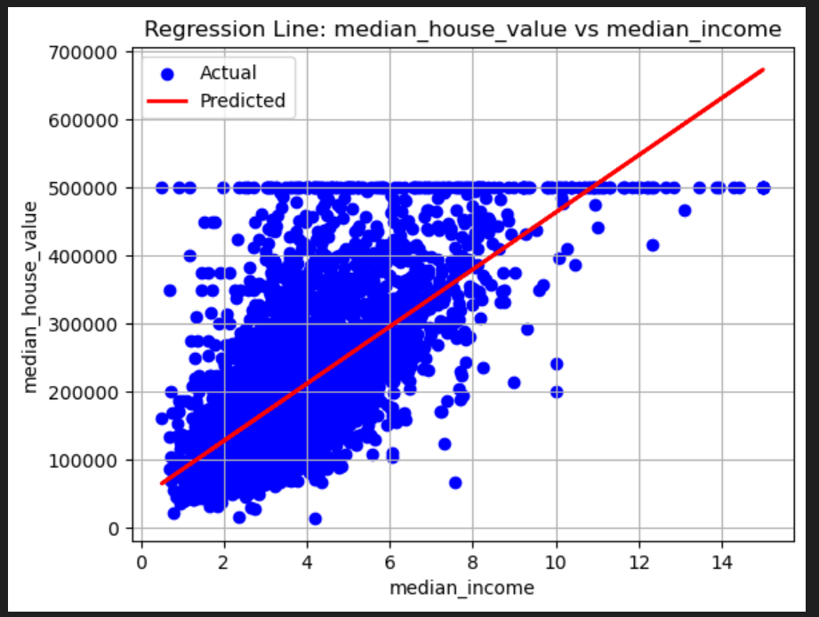
Mean Squared Error (MSE): 7091157771.76555
Mean Absolute Error (MAE): 62990.86530093761
R2 Score: 0.45885918903846656
*>So the percentage of mean squared error is 45.88%

Slide 3
What the Graph Shows:
Blue dots (Actual): Each point represents actual data from the dataset, showing what the median house value is for a given median income.
Red line (Predicted): This is the regression line, representing the predictions of a linear regression model trained to estimate median_house_value based on median_income.
Observations:
Positive Correlation:
There's a positive linear trend—as median_income increases, median_house_value tends to increase as well.
This makes sense—higher income often leads to higher housing prices.
Prediction Line (Red Line):
The regression model attempts to fit a straight line through the data.
It's a simple linear regression that tries to minimize the difference between the predicted values (on the red line) and the actual data points (blue dots).

Slide 4
Data Clipping or Ceiling Effect:
Many data points are "stacked" at the 500,000 value on the y-axis, forming a flat horizontal line.
This suggests there's a cap on median_house_value (possibly due to data collection limits or regulation), meaning house values above that aren’t shown accurately.
This affects the model's accuracy, especially at higher income levels.
Limitations:
Not a perfect fit: The data is widely scattered around the regression line, suggesting that median_income alone is not enough to accurately predict house values.
Outliers & Non-linear Trends: The spread indicates that a more complex model (like polynomial regression or decision trees) might perform better.

Slide 5
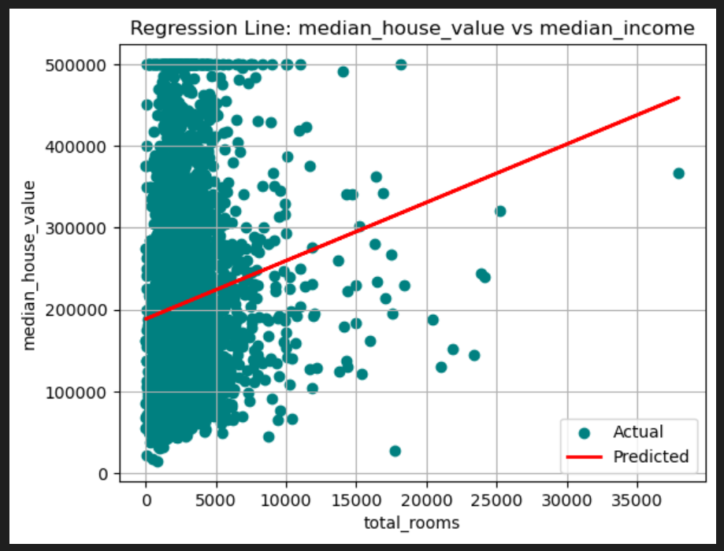
Mean Squared Error (MSE): 12868608472.627417
Mean Absolute Error (MAE): 89419.4255544871
R2 Score: 0.017970062300526446
*>So the percentage of mean squared error is 1.79%

Slide 6
What the Graph Shows:
X-axis: total_rooms — Total number of rooms in a housing block.
Y-axis: median_house_value — The median value of houses in that block.
Blue dots: Actual data points.
Red line: Predictions from a linear regression model.
Observations:
Weak Positive Correlation:
The regression line slopes upward, indicating a weak positive relationship — as total_rooms increases, median_house_value also tends to increase slightly.
However, the relationship is not strong, as the data is very widely scattered.
High Concentration at Lower total_rooms:
Most data points are concentrated between 0 and 10,000 total rooms.
Beyond that, the number of data points decreases significantly.

Slide 7
High Variance:
The spread of points for any given number of rooms is large, showing that total_rooms is not a strong predictor of median_house_value on its own.
This makes the linear model less accurate.
Limitations of Using total_rooms:
Not a good standalone feature: Total number of rooms doesn’t account for lot size, room size, or number of houses per block, which are also critical.
Could be improved by using rooms per household or median rooms per house instead of total rooms.
Also suggests the need for feature engineering or normalization.

Slide 8
THANK YOU!

