Slide 1
Unsupervised Learning with PCA and Clustering
Submitted by:
NAME | REGISTRATION NO.
SUVASHREE ROUT | 2201020258
SARASWATI SWAIN | 2201020259
ARYAN SINGH | 2201020249
SMRUTI RANJAN BALABANTRAY | 2201020416

Slide 2
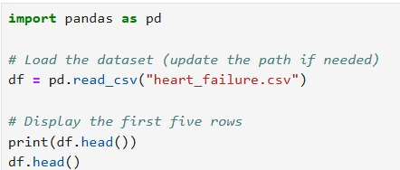
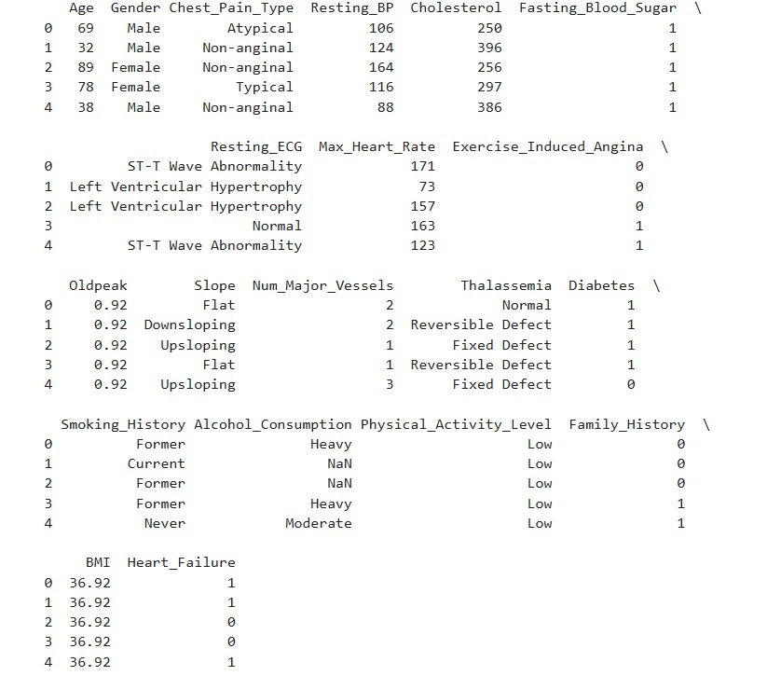
Load the dataset and display the first few rows :

Slide 3
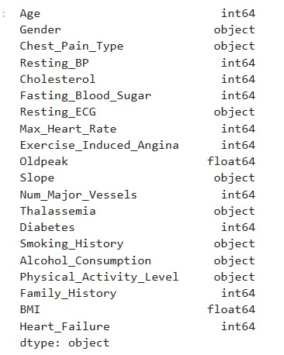

Check for missing values and confirm data types :

Slide 4

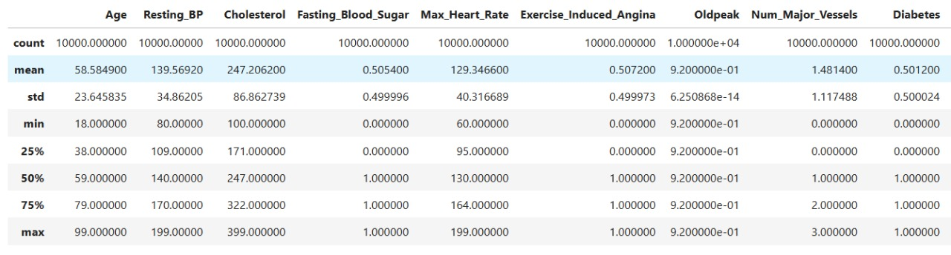
Generate summary statistics for each feature :

Slide 5
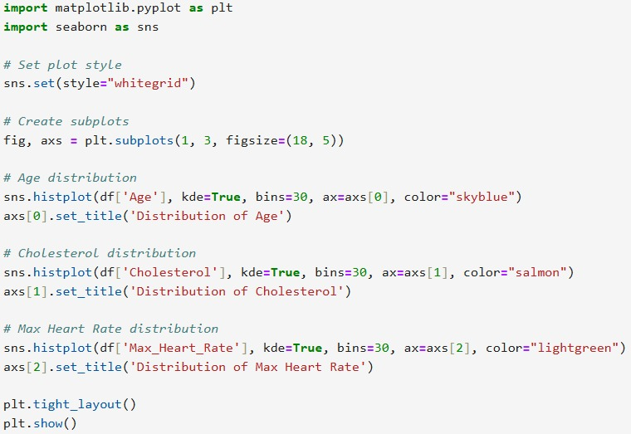
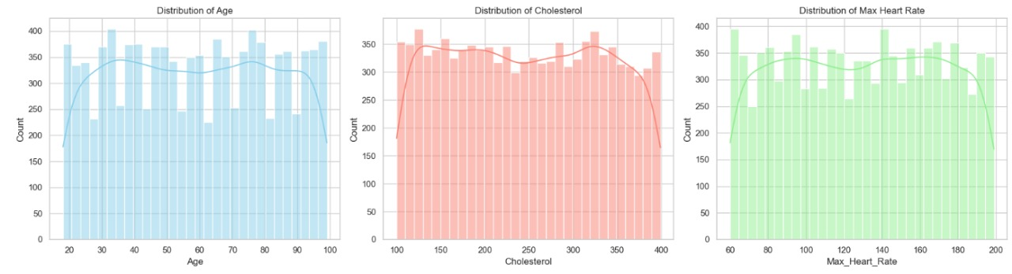
Visualize distributions of key features (e.g., age, ejection_fraction, serum_creatinine) :

Slide 6
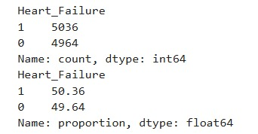
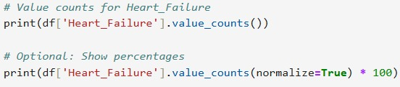

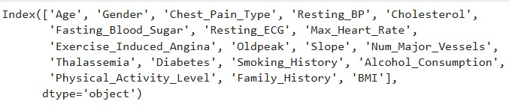
Comment on the overall balance of the dataset based on the death_event column :
Drop the death_event column(not needed for unsupervised learning :

Slide 7
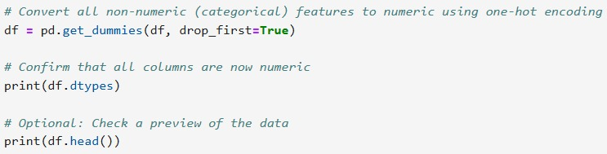
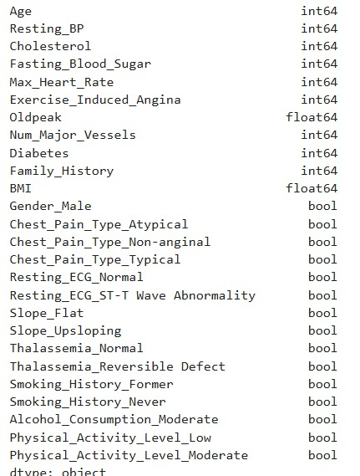
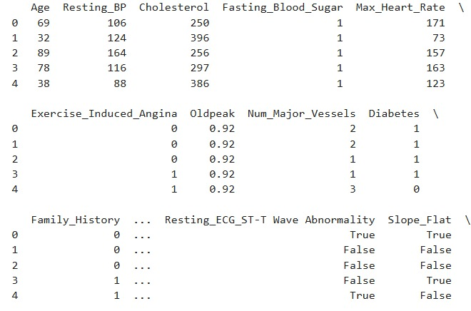
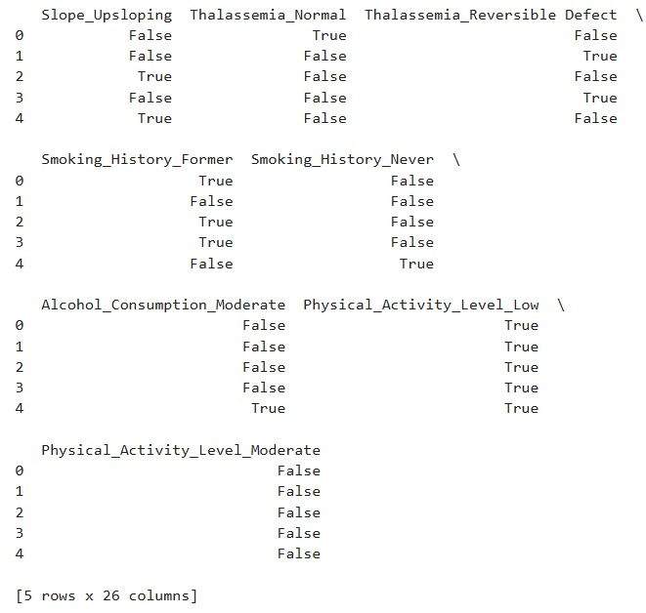
Ensure all remaining features are numerical :

Slide 8
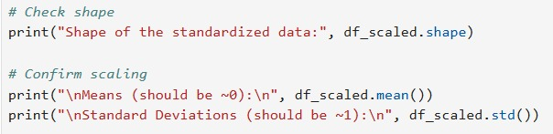
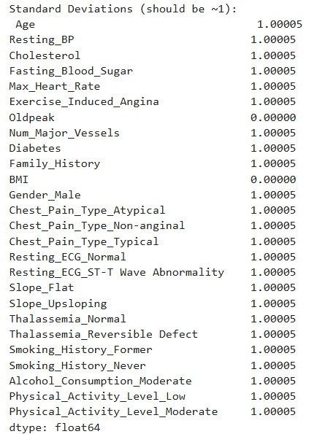
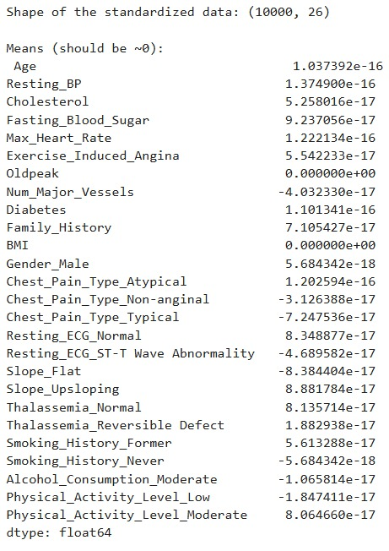
Standardize the features using a method like standardScaler :

Slide 9
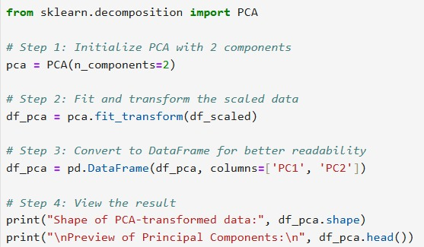
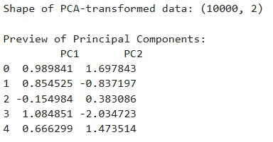


Confirm the shape and scaling of the data :
Apply PCA to reduce the dataset to 2 principal components :

Slide 10
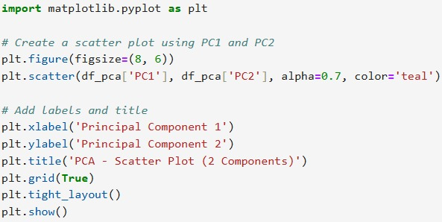
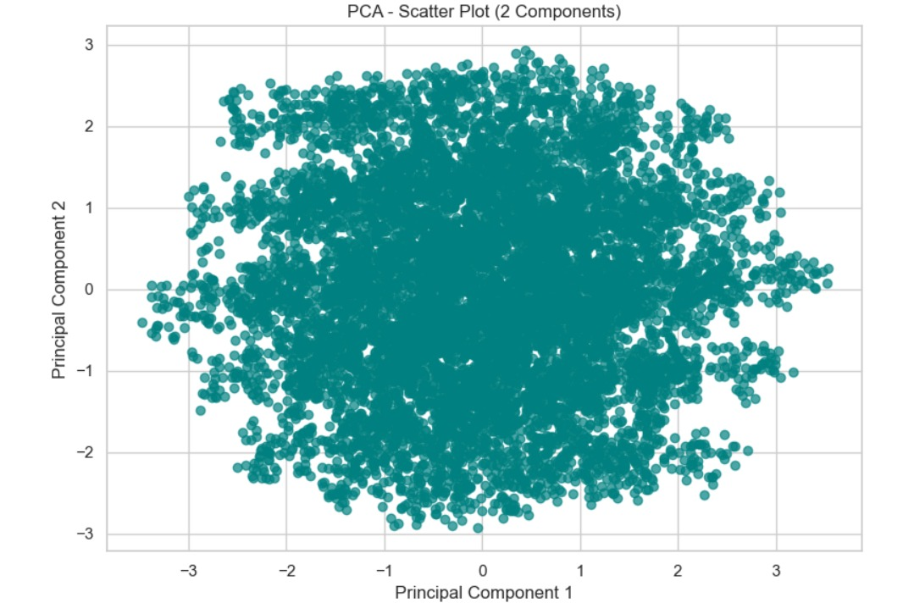
Print the explained variance ratio for each component :

Slide 11
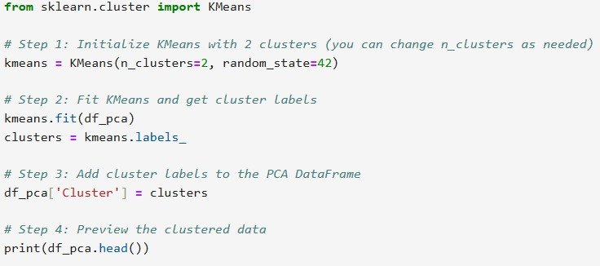
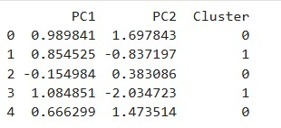
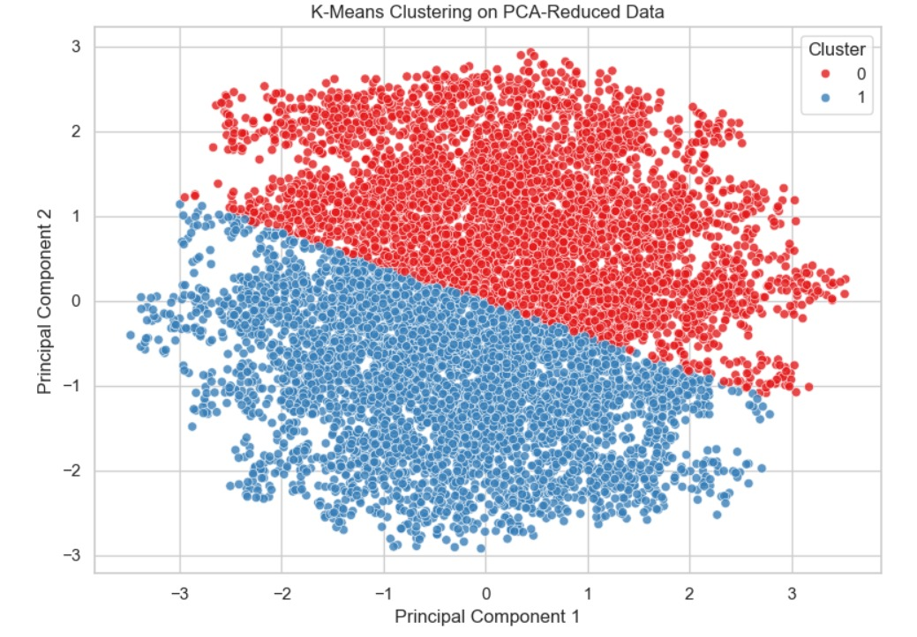
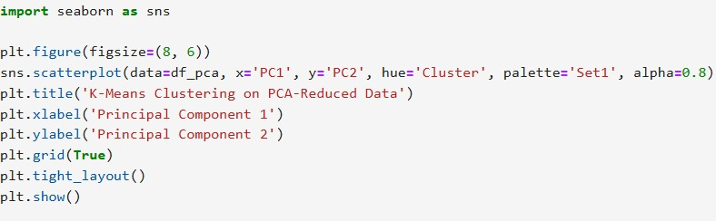
Create a scatter plot using the two principal components :

Slide 12
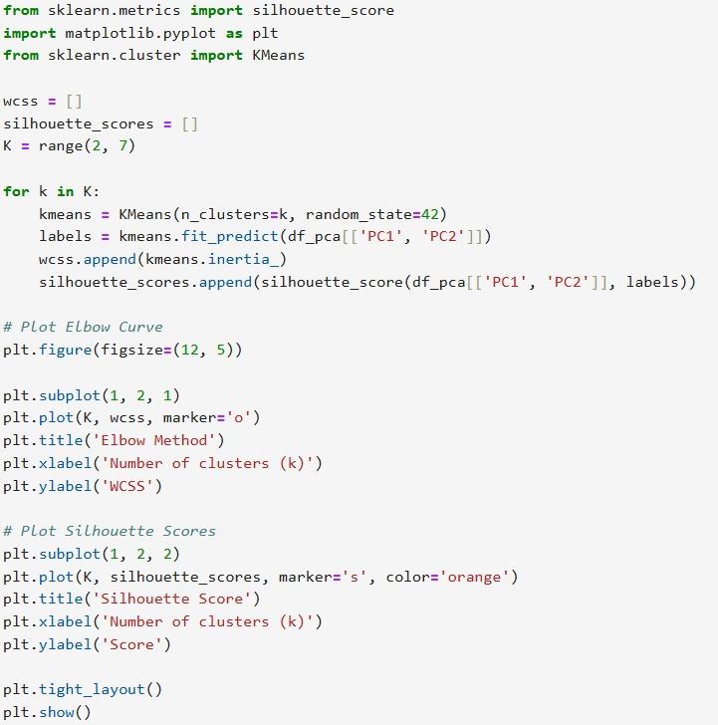
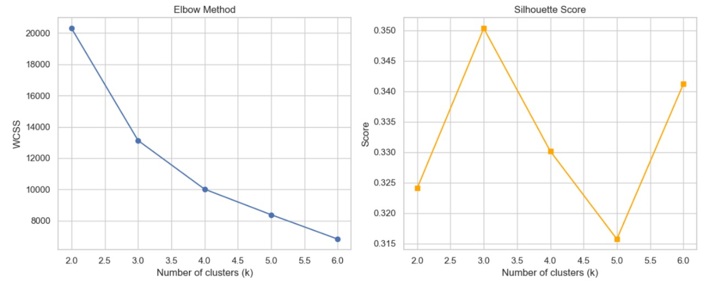
Use the PCA-reduced data to apply K-Means clustering :

Slide 13
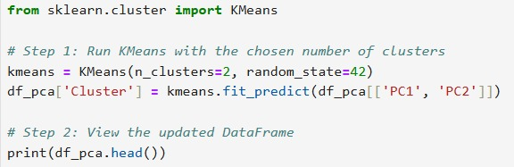
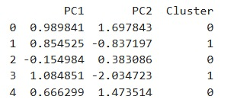
Select an appropriate number of clusters (e.g., 2 or 3) and explain your choice :

Slide 14
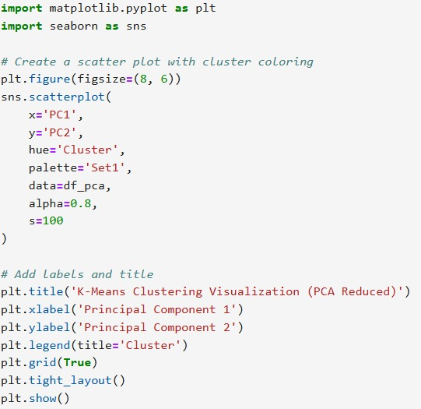
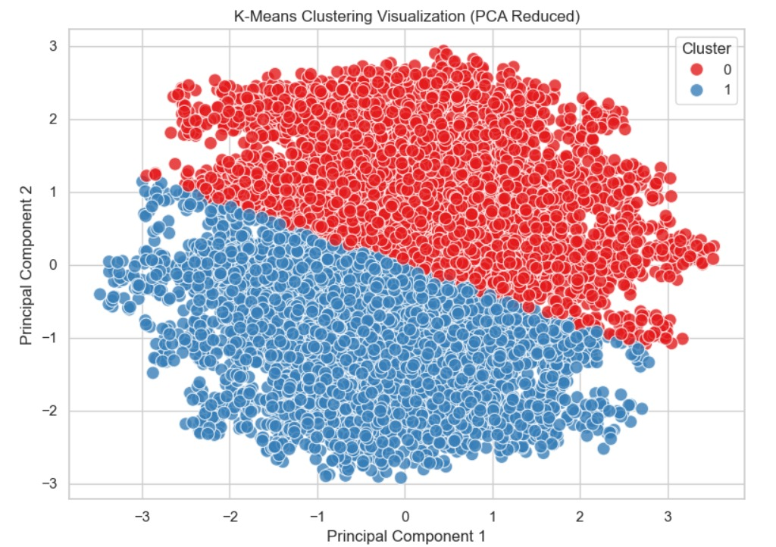
Assign a cluster label to each record :

