Slide 1
Cranes Presentation:
Heart Failure Clustering
Saquib Khan, Shakti Prasad Swain, Manoj Samal, Samsuddin Rahil
Group 6, Subgroup 18
Link to my Colab Notebook: My Notebook

Slide 2
Dataset Description
The dataset contains clinical records of heart failure patients, with each row representing a patient and columns describing their characteristics. Key features include:
Demographics : Age, Sex.
Symptoms : Chest pain type (e.g., Typical, Atypical, Non-anginal, Asymptomatic).
Vital Signs : Resting blood pressure, Cholesterol levels, Heart rate.
Diagnostic Results : ECG findings (e.g., Normal, ST-T Wave Abnormality, Left Ventricular Hypertrophy), Thalassemia type (e.g., Fixed Defect, Reversible Defect).
Lifestyle Factors : Smoking status, Alcohol consumption, Physical activity level.
Target Variable : Presence or absence of heart failure.
The data is numerical and categorical, suitable for exploratory analysis, clustering, and predictive modeling.

Slide 3
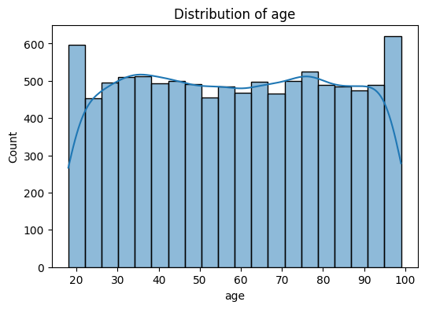
The peak around the 30–60 age range highlights that middle-aged adults are the primary demographic in the dataset.
The tail extending to higher ages indicates that older patients are also represented.
The presence of younger patients (ages 20–30) suggests that heart failure can occur in younger individuals, possibly due to specific risk factors.

Slide 4
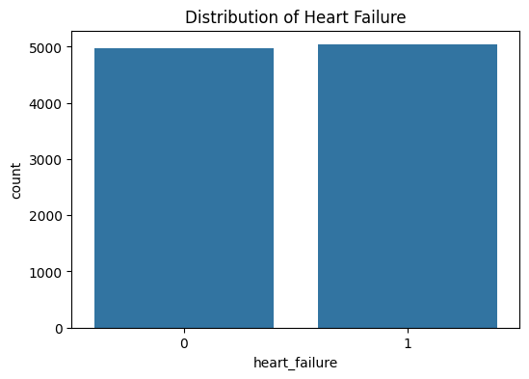
The number of patients without heart failure (heart_failure = 0) is roughly equal to the number of patients with heart failure (heart_failure = 1).
This suggests that heart failure is a common condition among the patients in the dataset, affecting approximately half of the population.
The high prevalence of heart failure indicates that the dataset is suitable for studying risk factors and patterns associated with heart failure.

Slide 5
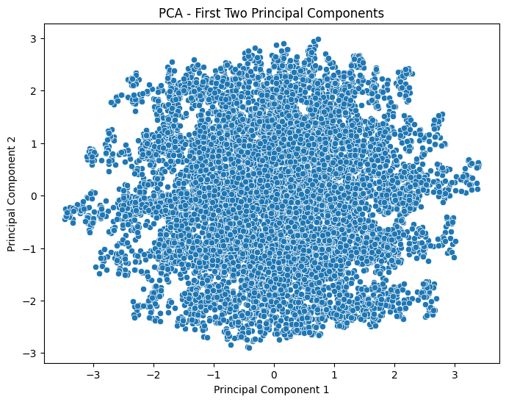
x-axis -> (PC1): captures the most variance in the data
y-axis -> (PC2): captures the second-highest variance in the data.
Central Clustering : Most of the data points are concentrated near the origin (0, 0), suggesting that the majority of the variability in the dataset is captured by these two components.
No Clear Separation : There are no distinct clusters or patterns visible in the plot, implying that the underlying structure of the data may require clustering to uncover meaningful groupings.

Slide 6
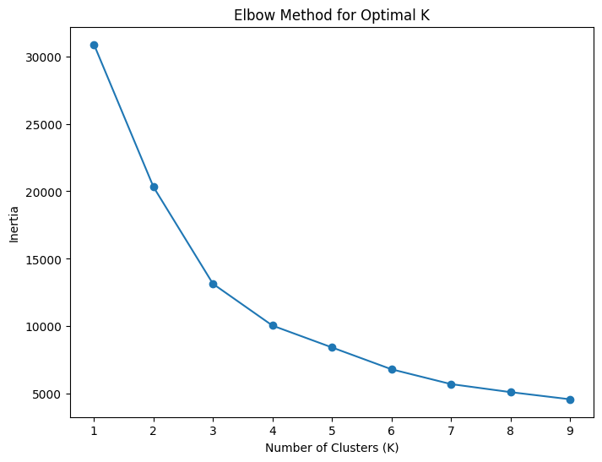
The x-axis represents the number of clusters (K) , and the y-axis represents the inertia (sum of squared distances of samples to their closest cluster center).
The optimal number of clusters appears to be K = 3, where the inertia drops significantly compared to K = 2, but beyond K = 3, the decrease in inertia is less pronounced.
Choosing K = 3 balances model complexity and performance.

Slide 7
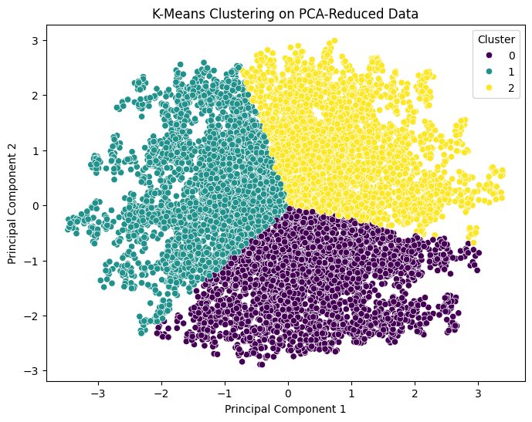
The clear separation of clusters indicates that the K-Means algorithm successfully identified meaningful groupings in the data when projected onto the first two principal components.
These clusters likely correspond to different subgroups of patients based on their clinical characteristics.
The overlapping regions suggest that some patients share similarities with multiple clusters

