Slide 1
Heart Failure Prediction Analysis
Name Reg. number
Ujjawal Kumar Verma 2201020428
Abhishek Kumar 2201020642
Nitish Paramanik 2201020433
Ravi Anjan Kumar 2201020409

Slide 2
Table of contents
01
02
03
05
Introduction
Dataset Importing
Age & BMI Distribution
04
06
PCA for Dimensionality Reduction
K-Means Clustering
Conclusion & Interpretation

Slide 3
Introduction
🔹 What is K-Means Clustering?
Unsupervised machine learning algorithm.
Groups data into K distinct clusters based on feature similarity.
Iteratively assigns each point to the nearest cluster centroid
🔹 Why Use K-Means on Health Data?
Helps identify hidden patient subgroups based on multiple health parameters.
Useful for risk stratification, treatment planning, or early intervention.
🔹 What is PCA (Principal Component Analysis)?
Dimensionality reduction technique.
Converts high-dimensional data into 2 or 3 principal components.
Helps visualize clustering and reduces noise.
🔹 Why PCA + K-Means?
Real-world medical data is high-dimensional.
PCA makes K-Means faster and more interpretable.
Easy to visualize cluster separations in 2D plots.

Slide 4

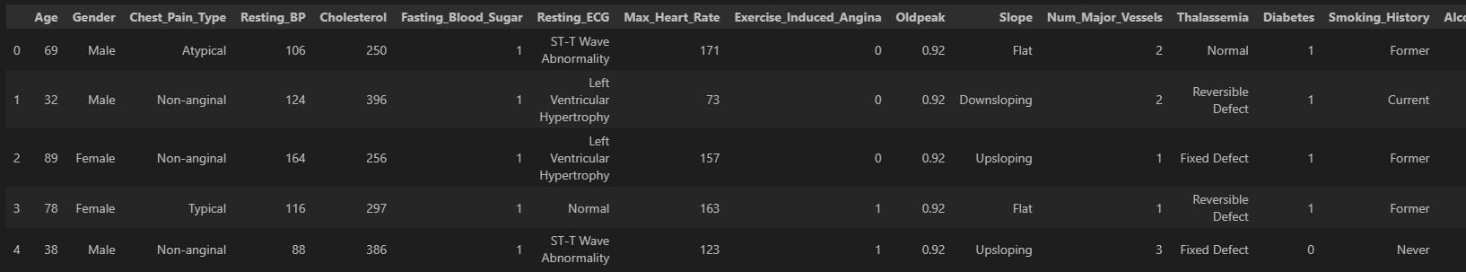
Dataset Importing

Slide 5
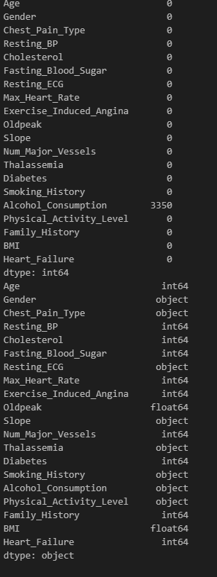
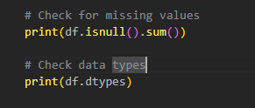
Check for missing values

Slide 6
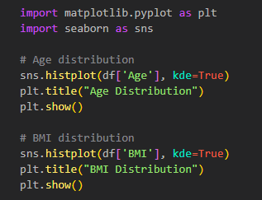
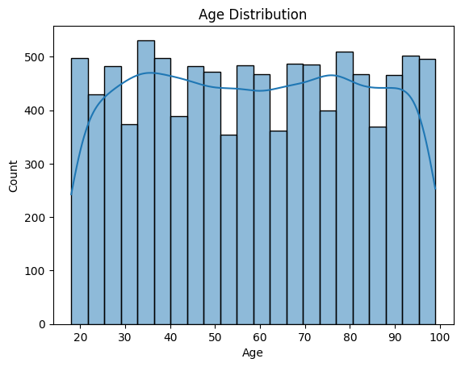
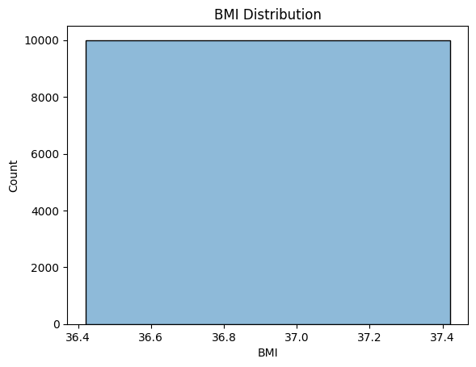
Age & BMI Distribution

Slide 7
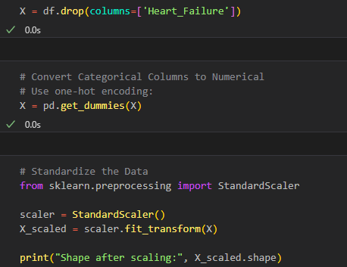
Feature Selection & Preprocessing

Slide 8
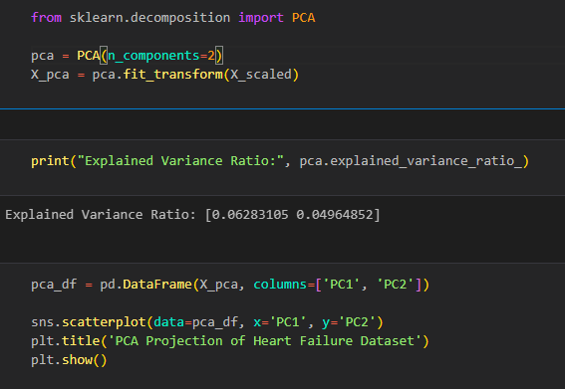
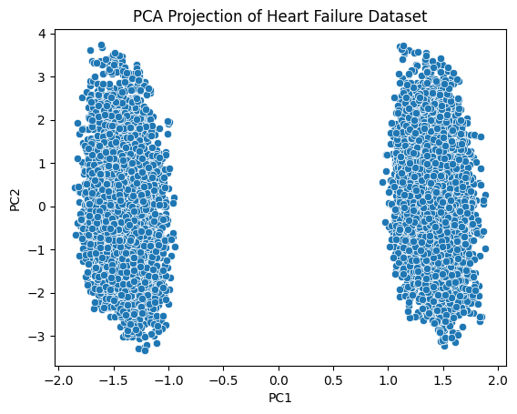
PCA for Dimensionality Reduction

Slide 9
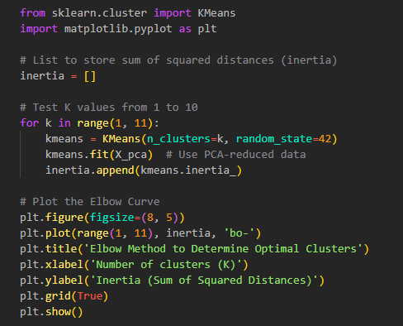
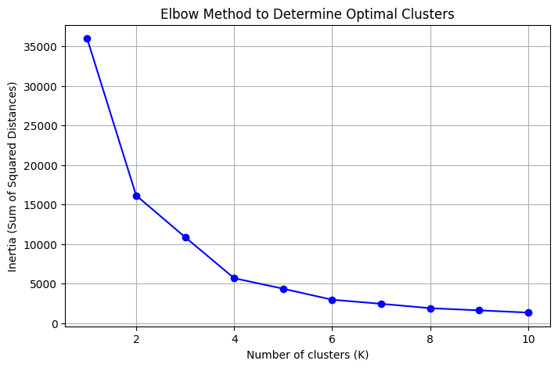
Elbow Method

Slide 10
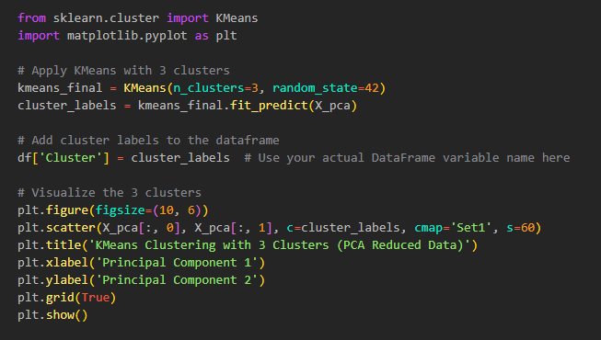
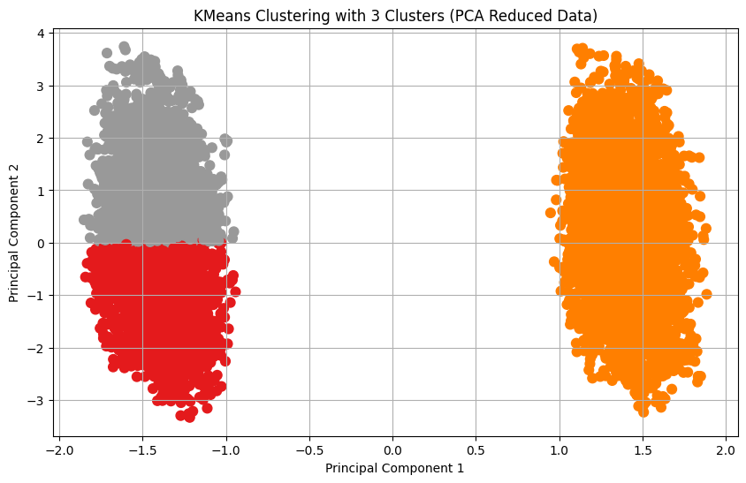
K-Means Clustering

Slide 11
Interpretation (PCA + Clustering)
PCA reduced high-dimensional data into 2 key components (PC1 & PC2), capturing most variance and enabling easy visualization.
K-Means Clustering revealed distinct patient groups based on clinical features.
Observations:
Clear cluster separation in PCA plot suggests meaningful grouping.
Clusters may reflect:
Group 1: High-risk patients (older, high BP/cholesterol, smokers, low activity).
Group 2: Low-risk patients (younger, healthier profiles).
Insights:
Helps in early risk identification and personalized care.
Valuable for targeting preventive or intensive treatments.
Conclusion & Interpretation

