Slide 1


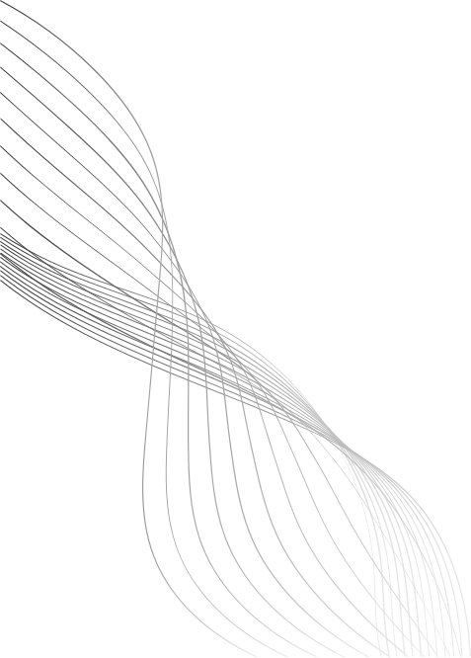
AI & DS PRESENTATION
GROUP-9
SUBMITTED BY:
SWAGAT PRITAM SAHOO(2201020425)
TANUJA SHREE (2201020427)
SAURABH KUMAR MOHANTA(2201020431)
SANDEEP BISWAL (2201020443)

Slide 2
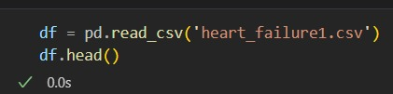
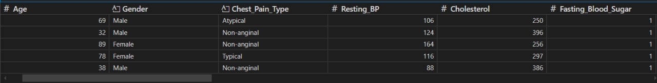
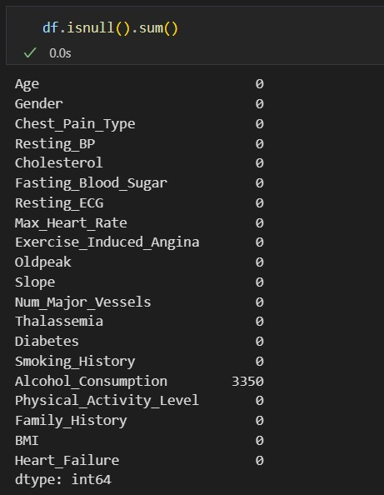
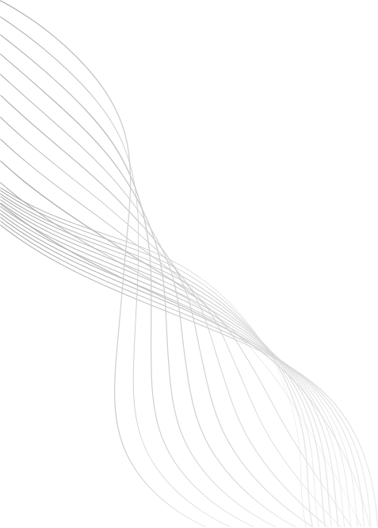
DATA ANALYSIS
01

Slide 3
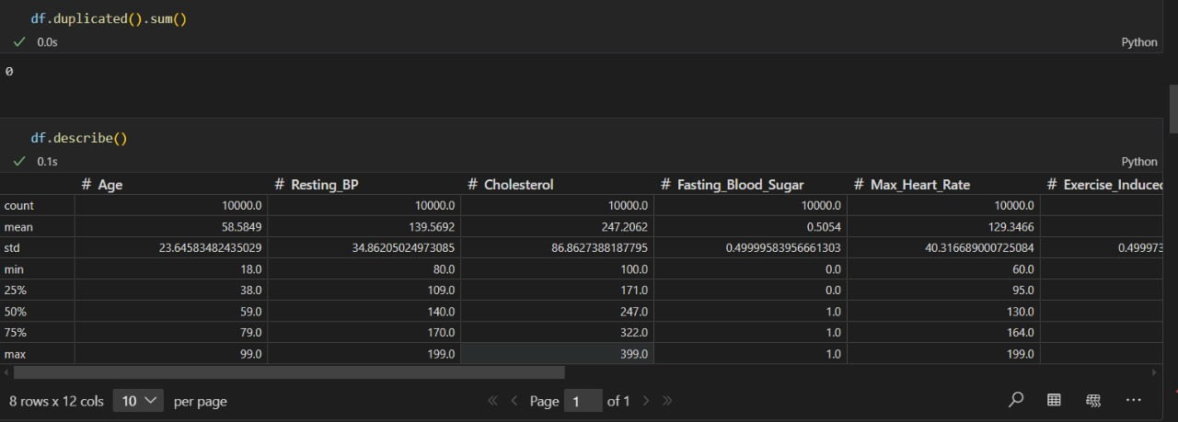
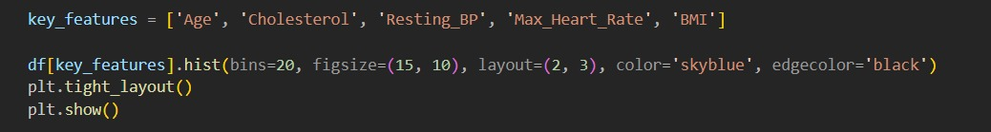
CODE HISTOGRAM DESCRIPTION:
02

Slide 4
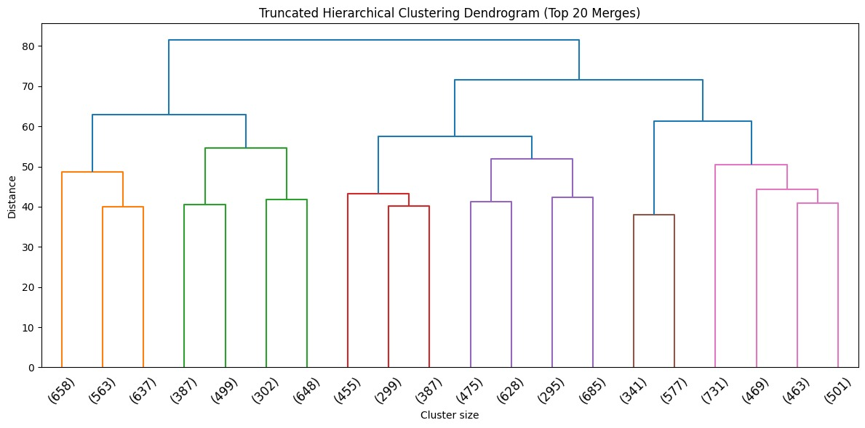
DENDROGRAM OF 20 SAMPLES
from scipy.cluster import hierarchy as sch
linkage_matrix = linkage(x_scaled, method='ward')
plt.figure(figsize=(12, 6))
sch.dendrogram(linkage_matrix, truncate_mode='lastp', p=20, leaf_rotation=45., leaf_font_size=12.)
plt.title('Truncated Hierarchical Clustering Dendrogram (Top 20 Merges)')
plt.xlabel('Cluster size')
plt.ylabel('Distance')
plt.tight_layout()
plt.show()
03

Slide 5
ANALYSIS
The truncated hierarchical clustering dendrogram displays the top 20 merges using the Ward method, with the y-axis indicating the distance between merging clusters. Early merges such as (65,81) and (55,91) occur at very low distances, highlighting pairs of highly similar observations. The repeated involvement of observation 71 in merges like (63,71) and (38,71) at relatively higher distances suggests potential outliers or distinct subgroups within the data. The varying merge distances, from very low (e.g., (40,41)) to significantly higher (e.g., (73,1)), reveal uneven cluster densities, indicating that some groups form more tightly than others. The truncation focuses on the most significant merges, emphasizing key clustering patterns while omitting finer details, which would require examining the full dendrogram or underlying data for deeper insights. The Ward method’s preference for similarly sized clusters is evident, though natural variations in density are still apparent.
07

Slide 6
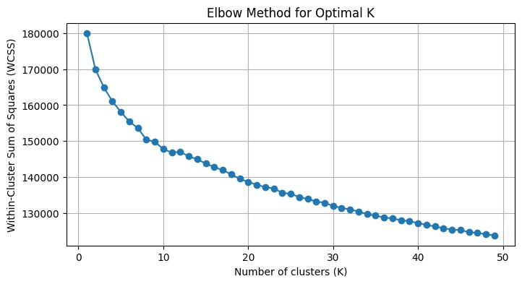
ELBOW METHOD
wcss = []
for k in range(1,50):
Kmeans = KMeans(n_clusters=k, random_state=42)
Kmeans.fit(x_scaled)
wcss.append(Kmeans.inertia_)
plt.figure(figsize=(8, 4))
plt.plot(range(1, 50), wcss, marker='o')
plt.title('Elbow Method for Optimal K')
plt.xlabel('Number of clusters (K)')
plt.ylabel('Within-Cluster Sum of Squares (WCSS)')
plt.grid(True)
plt.show()
04

Slide 7
ANALYSIS
The elbow plot shows the relationship between the number of clusters (K) and the Within-Cluster Sum of Squares (WCSS), where WCSS decreases as K increases. The "elbow point"—where the rate of decline sharply slows—suggests the optimal K for K-means clustering. In this case, the plot does not show a clear sharp elbow, indicating that the data may not have very distinct clusters or may require alternative methods (e.g., silhouette analysis) to determine K. A gradual decline implies that increasing K further reduces variance but may lead to overfitting. The optimal K is likely where the curve starts to flatten significantly.
07

Slide 8
CONCLUSION
The hierarchical dendrogram reveals clusters with varying similarity levels, suggesting some natural groupings but no sharply defined structure. The elbow method’s lack of a clear optimal K further indicates that the data may not have distinct clusters or requires alternative validation techniques. Together, these results imply that the dataset has gradual or overlapping groupings, making cluster interpretation subjective. A combined approach—using silhouette analysis or domain knowledge—would help refine the clustering outcome.
09

Slide 9
THANK YOU
10

