Slide 1
Brain Tumor Classification

Slide 2
TEAM MEMBERS:
SL. NO | NAME | REGD NO.
1 | CHINMAY PRADHAN | 2201020618
2 | RABI SHANKAR PANDA | 2201020599
3 | SHREEYA PUHANA | 2201020434
4 | SHIBASIS BUGUDEI | 2201020644

Slide 3
Introduction & Background
Problem Statement
  Brain tumors grow rapidly, causing severe neurological damage if undetected. Accurate classification is essential for effective diagnosis and treatment.
Significance
  Existing models struggle with imbalanced datasets and tumor variability. Deep learning offers promise but requires robust methods.
Objectives
  Develop a reliable MRI-based model for Glioma vs. No Tumor classification.
  Analyze the impact of activation functions on performance.
Context
  Prior models (SVM, CNNs) achieved 70-95% accuracy but lacked efficiency. Advanced architectures like Xception show potential for superior results.

Slide 4
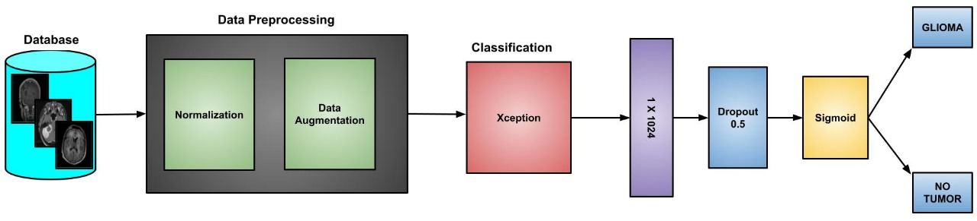
Methodology
Approach
Xception architecture with transfer learning; fine-tuned custom dense layers for Glioma vs. No Tumor classification.
Preprocessing
Images resized to 299×299, normalized (scaled [0, 1]), and augmented (random flips, zooms, rotations).
Model Features
Pre-trained ImageNet weights, ReLU activation with a 1024-unit dense layer, early stopping, and checkpointing to avoid overfitting.

Slide 5
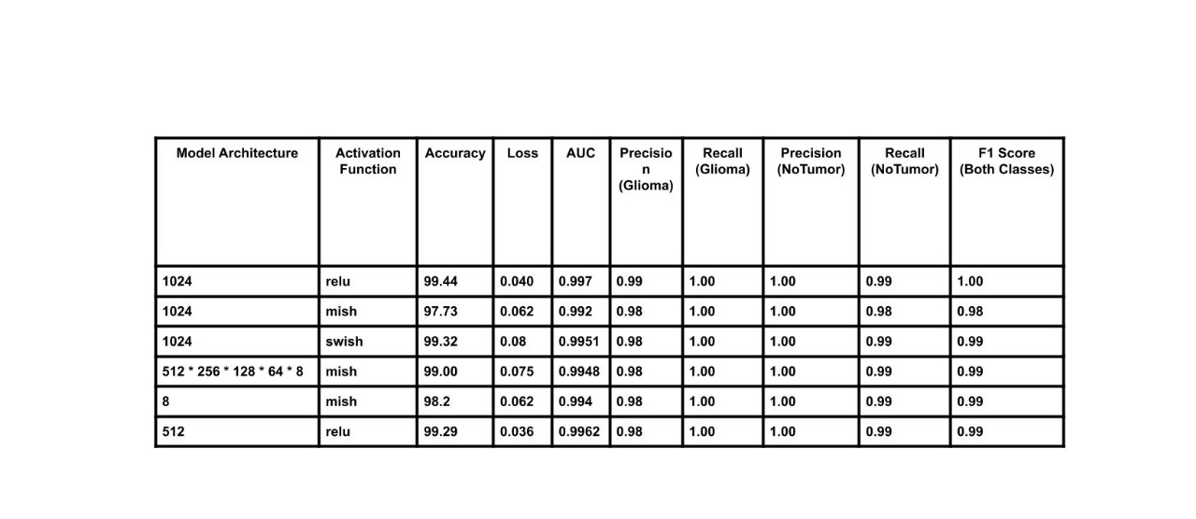
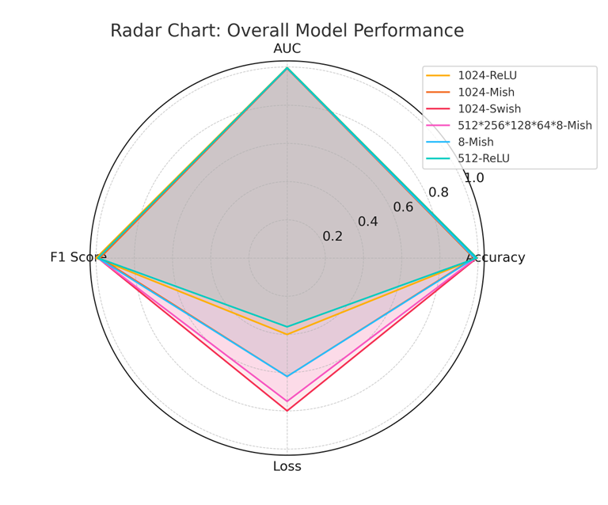
Results
Metrics
  Precision: 1.00 (No Tumor), 0.99 (Glioma)
  Recall: 1.00 (Glioma), 0.99 (No Tumor)
  F1 Score: 1.00
Key Findings
Achieved 99.44% accuracy and AUC of 0.997 with ReLU-based architecture, outperforming Mish and Swish.

Slide 6
Conclusion & Future Scope
Summary
  Proposed model using Xception architecture with ReLU-based custom dense layers achieved 99.44% accuracy for Glioma and No Tumor classification.
  Data augmentation and robust optimization methods ensured strong generalization and reduced overfitting.
Future Scope
  Extend to multi-class classification by including more tumour types.
  Integrate Explainable AI (XAI) for better clinical interpretability.
  Explore hybrid architectures for enhanced diagnostic accuracy.

Slide 7
Selected References
Jia, Z., & Chen, D. (2024). Brain tumor identification and classification of MRI images using deep learning techniques.
Fayed, L. (2023) Could it be a brain tumor?, Verywell Health. Available at: https://www.verywellhealthcom/symptoms-of-brain-tumors-513565.
Haque, R. et al. (2024) ‘Neuronet19: An explainable deep neural network model for the classification of brain tumors using magnetic resonance imaging data’, Scientific Reports, 14(1). doi:10.1038/s41598 024-51867-1.
Mohsen, H., et al. (2018). Classification using deep learning neural networks for brain tumors.
Korfiatis, P., et al. (2016). Automated segmentation of hyperintense regions in Flair MRI using Deep Learning.
Sobhaninia, Z., et al. (2018). Brain tumor segmentation using deep learning.

Slide 8
THANK YOU

